Slide 1
Behavior, Environment and STAR Update Training
Marcia Braden, PhD
SLV BOCES
August 15 and 16, 2016

Slide 2
Schedule Day One
8:00-8:15 Check in
8:15-8:30 Introductions, catch up
8:30-9:30 The Reasons for Behavioral Excesses
9:30-10:30 Developing a Sound Behavioral Plan and Implementing
10:30 Break
10:45 Establishing Instructional Control
11:30-12:30 Lunch
12:30-1:30 Setting up the Classroom Environment
1:30-2:30 Teaching Methods and Strategies to Support Behavioral Changes
2:30 Break
2:45-3:30 Considerations for Inclusion

Slide 3
In the Beginning…
We thought behavior occurred in isolation
We thought that one size of intervention would fit all types of children
Some believed that the behavioral problems in special populations was just part of the condition and should be accepted without attempting to change anything

Slide 4
Etiology Left Medicine and Entered Education
Generalists were no longer able to meet the unique needs of all special populations
With the revision of IDEA and the accompanying mandates, the one size fits all philosophy was abandoned
RtI grew out of the revisions in IDEA with emphasis on research based methodology
The push from parents of children with autism dovetailed with the revisions of the new mandate

Slide 5
The Balance
Behavior intervention is often unnecessary when etiology is considered
Understanding “hard wiring” of students makes disciplining archaic
Supporting students’ individual differences enables them to thrive, save face and take risks. Acting out, struggling for power and non compliance then become extinct …but this takes careful planning and understanding

Slide 6

Factors that Impact Behavior
Environment
Cognitive Curricular
Low interest materials
Communication delays
Physical
Symptoms/Anxiety
Sensory Integration Disorders

Slide 7
What I’ve learned about Autism and Behavior
They show or tell us what they need
It is our job to give them a more appropriate way to communicate their need
We have to observe the behavior looking for function in order to help modify the behavior

Slide 8
The Behavioral Cycle
Response from
Parent, teacher
Therapist
Neurobiological underpinnings
Gross and fine motor delays
Anxiety
Language delays
Sensory dysfunction
Running away
Throwing shoes
Hitting head
Pulling hair
Cognitive delays

Slide 9
Understanding Problem Behavior
Disruptive to home or school environment
Interferes with the child’s ability to learn
Interferes with other’s ability to learn
Presents danger to self or to others
Interferes with social acceptance

Slide 10
Foundations of Behavior
In order to change behavior we must first understand the foundational aspects of behavior.
All behavior serves a purpose.
Behaviors do not continue unless they are reinforced in some way.
Sometimes the reinforcing aspect of the behavior is internal.
If you do not address the cause of the behavior it will not change.

Slide 11
Functional Behavior Assessment
The ABC’s of Behavior
  Antecedent (the action that occurs directly before the behavior)
  Behavior (the specific act or behavior)
  Consequence( what happens directly after the behavior)

Slide 12
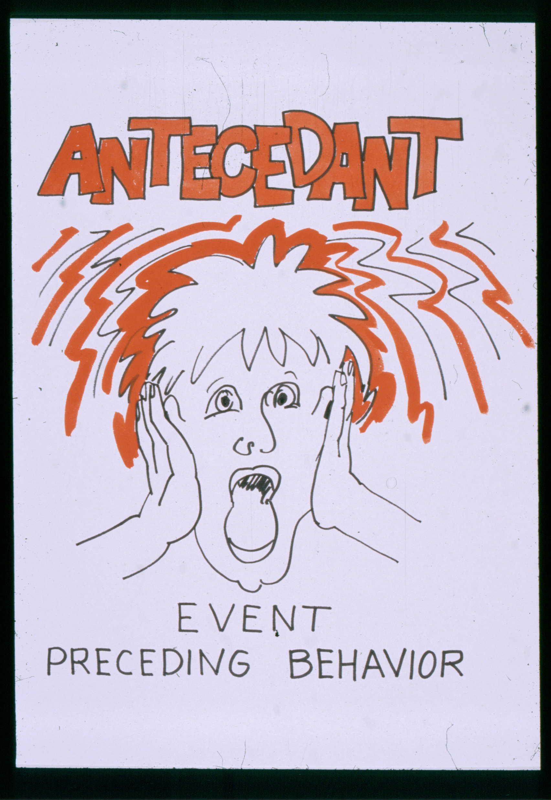

Slide 13
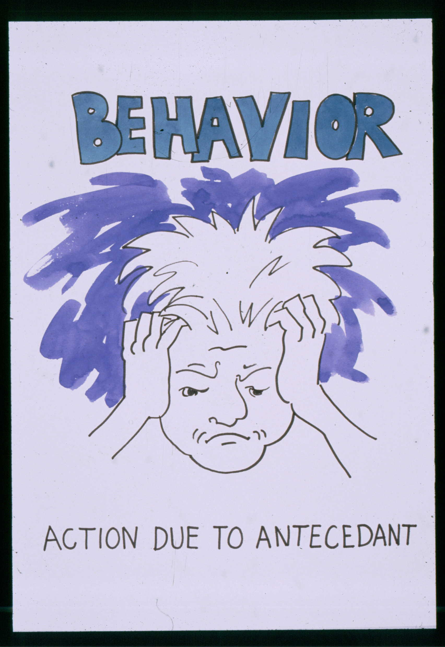

Slide 14
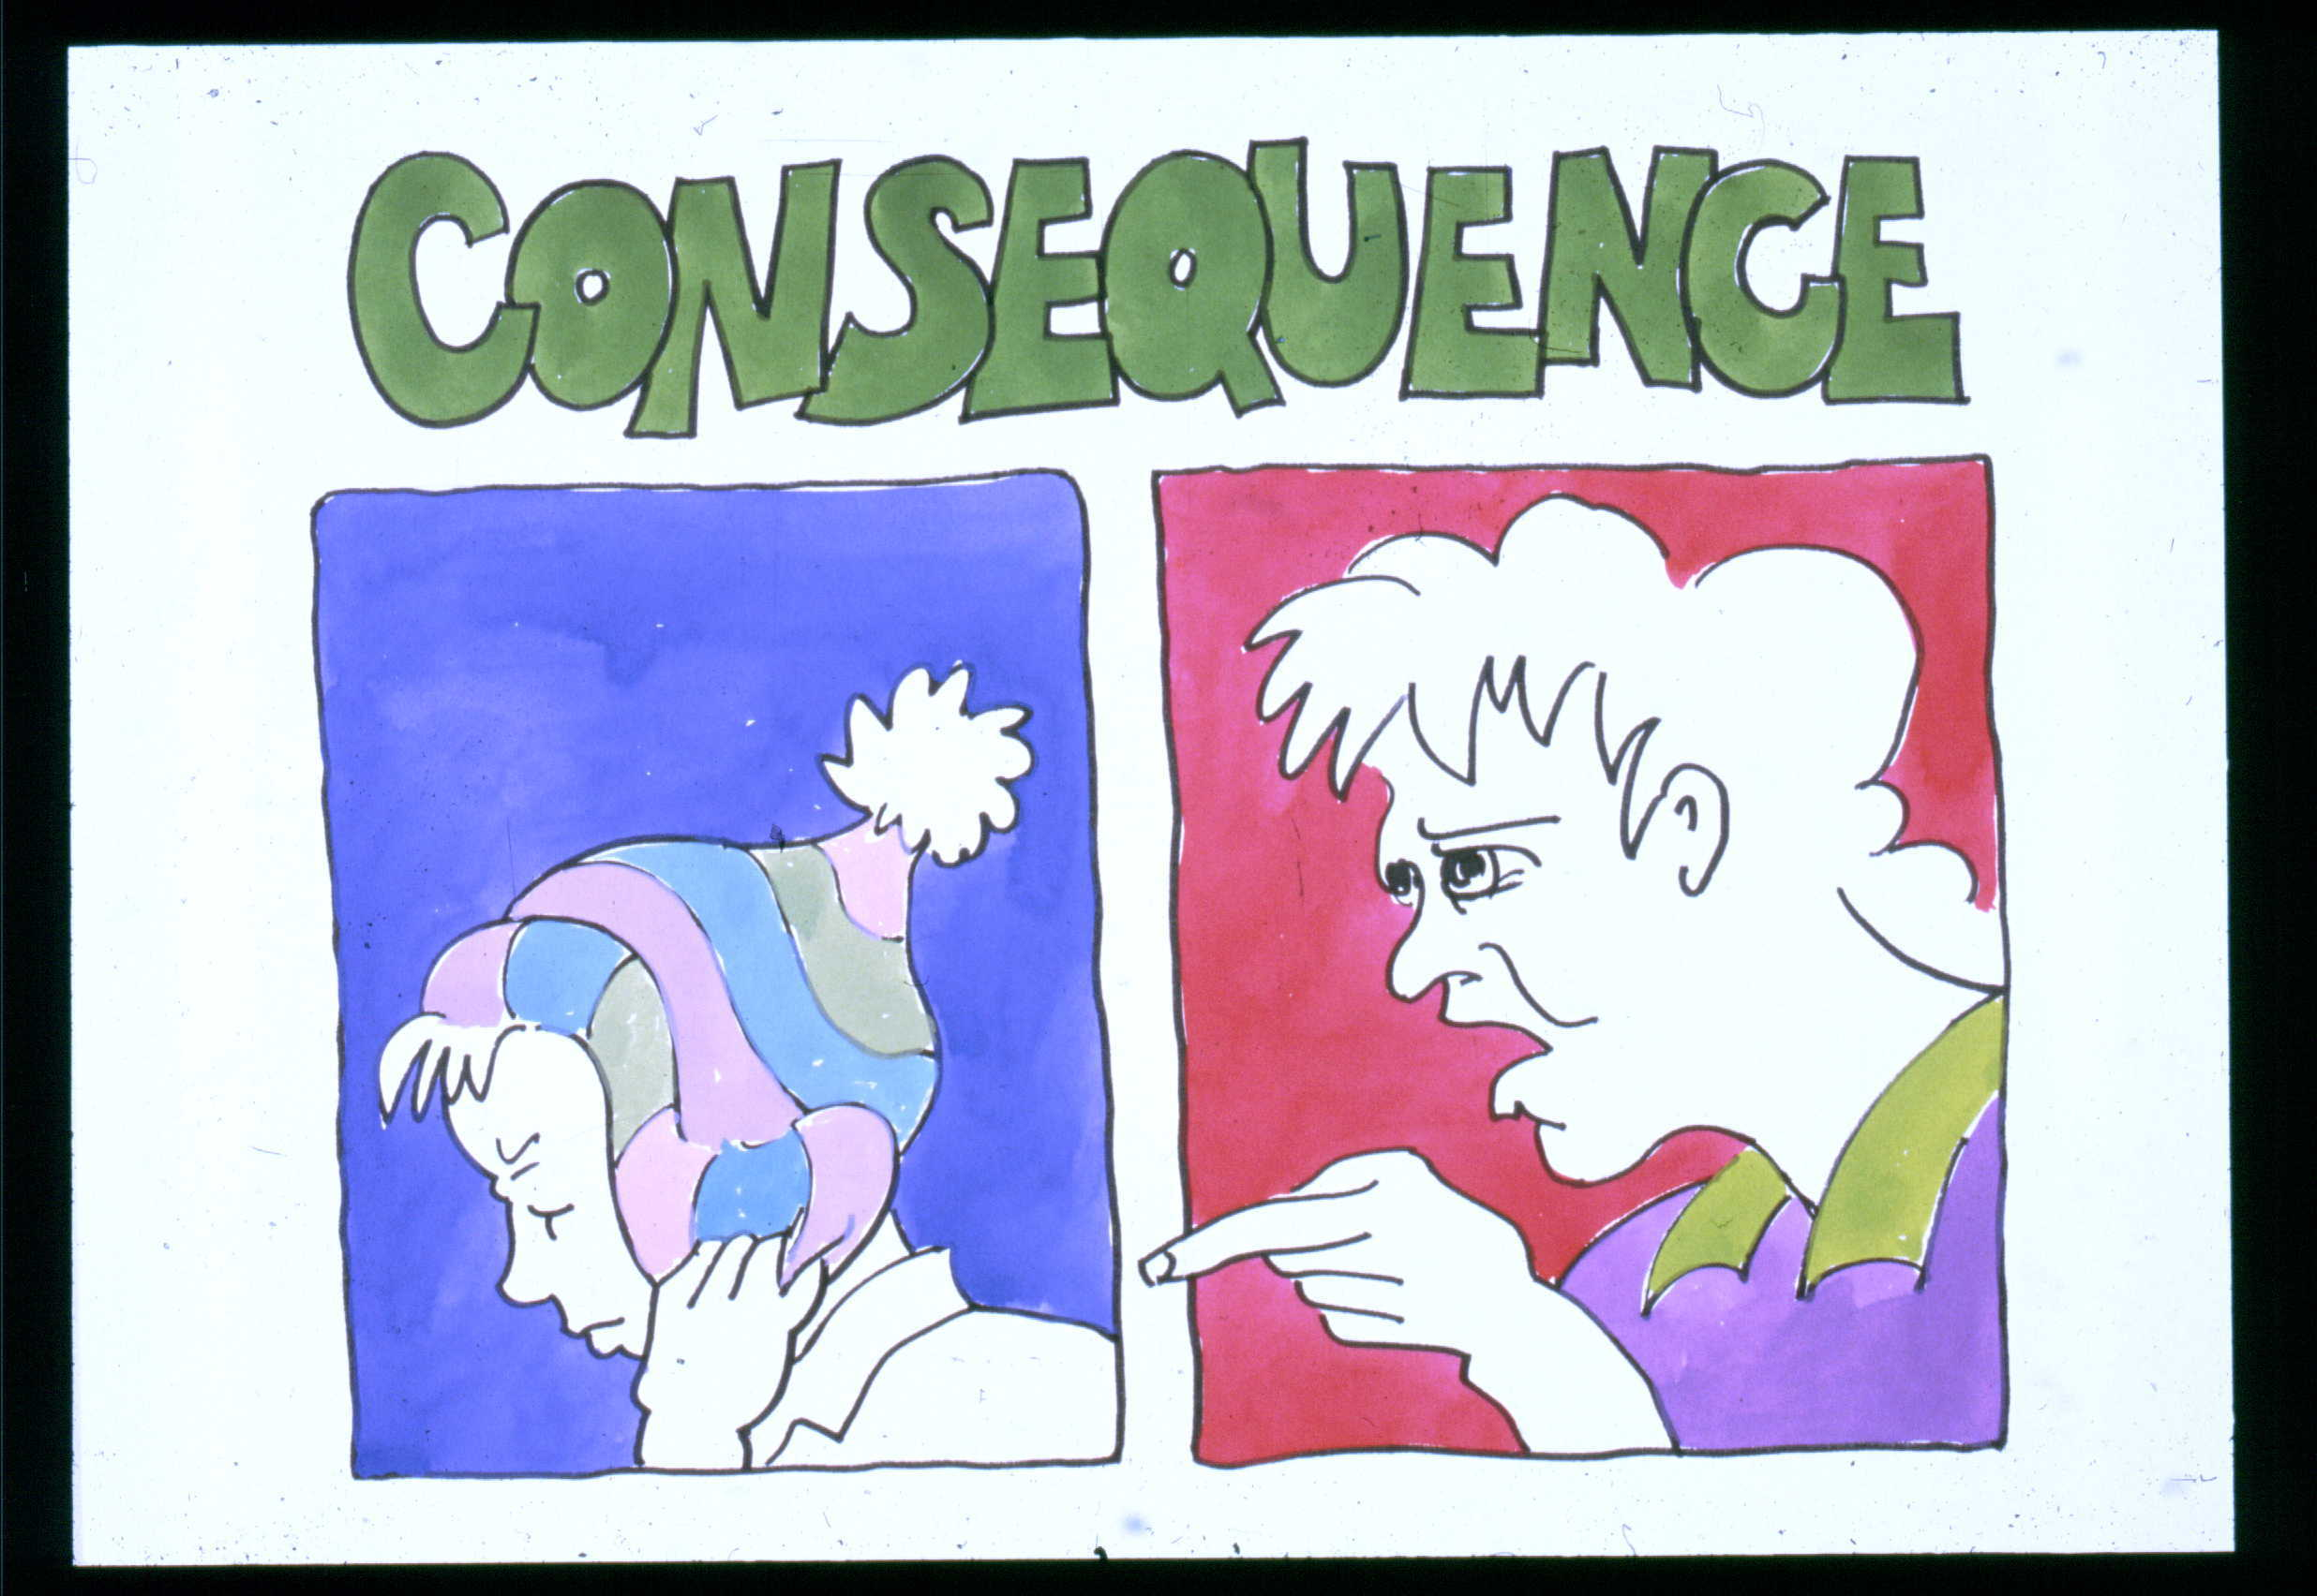

Slide 15
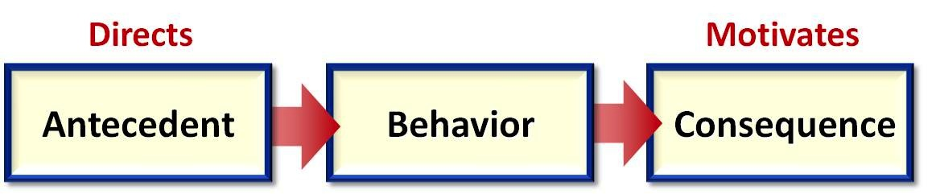
ABC’s of Behavior

Slide 16
ABC’s of Understanding Why students engage in problem behavior:
Finding out the Pay-off or Function of Behavior
A= Antecedent(s). Find out the events that occur right before the behavior.
  Allows you to predict: Where (During routine)? & When (Trigger event)?

Slide 17
ABC’s of Understanding Why students engage in problem behavior:Finding out the Pay-off or Function of Behavior
B=Behavior. Find out what is the observable problem behavior?
C=Outcome/ Consequence. Find out what happens after the behavior occurs? WHY?
A ➔ B ➔ C

Slide 18
The ABC Sequence
Antecedents or Triggers | Behavior | Consequence What is maintinaing the behavior?
Patrick is in a DT session and hits the trainer when she tells him to sit down

Slide 19
The ABC Sequence
Antecedents or Triggers | Behavior | Consequence What is maintinaing the behavior?
Patrick is in a DT session and hits the trainer when she tells him to sit down | Patrick hits the trianer

Slide 20
The ABC Sequence
Antecedents or Triggers | Behavior | Consequence What is maintinaing the behavior?
Patrick is in a DT session and hits the trainer when she tells him to sit down | Patrick hits the trainer | The trainer takes him to a new activity

Slide 21
The ABC Sequence- Consequences
Reinforcing the behavior increases the probability that the behavior will occur again
A behavior is increased in order to gain access to a positive reinforcer
A behavior is increased to get rid of a negative reinforcer
Example is a seat belt signal when it is not engaged
Extinction: If the rienforcer is not given, the behavior decreases
Punisher: Decreases the probability that the behavior will not occur again

Slide 22
The Power of the Consequence
Behaviors that are followed by pleasant consequences are more likely to occur again
It allows you to predict that the behavior will occur again
By changing the consequence you can change the future behavior

Slide 23
ABC Pattern Examples
Scenario 1
Scenario 2
Jane is ding the restroom routine
She finished rinsing her hands but continues to splash the water. Her trainer says, “turn off the water.”
Jane continues to splash in the water
The trainer repeats the direction to turn off the water several times
John’s dad takes him to the grocery store
John walks to the checkout stand and reaches for the gun
John’s dad says, “no gum today”
John screams and starts pacing back and forth
His dad is embarrassed and buys the gun and John is now quiet

Slide 24
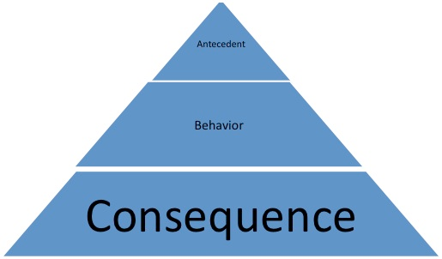
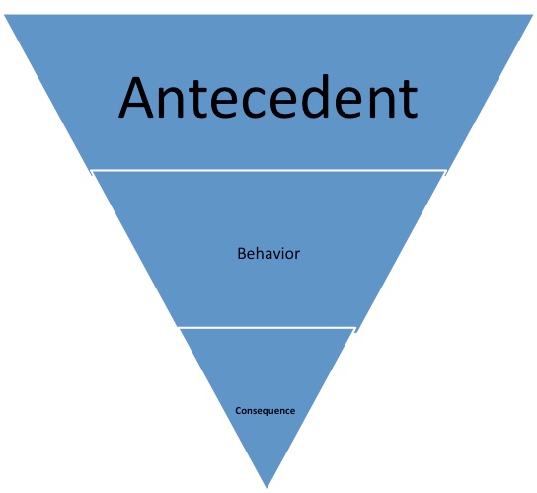
Flip the model

Slide 25
Determining the Antecedents
It is sometimes difficult to define the antecedents
It is difficult to know where to start
We often create additional issues through our attempts to make things better
When we make changes in a systematic way we can decrease the need for subsequent interventions

Slide 26
Common Antecedents
Removing or blocking access to preferred item or activity
Requiring compliance
Requesting completion of non preferred tasks
Participation in a group which is less structured or chaotic
Interrupting a play sequence or stopping before a task has been completed

Slide 27
Hidden Antecedents
Social
  Greetings, phone calls, introductions, novel social settings
Physical
  Ill
  Anxious, panicked, headaches, gastro intestinal issues
Curricular
  Tasks that are too difficult
  Lack of alternative curricula
Environmental
  Transitions
  Crowds
  Loud and unpredictable sounds

Slide 28
Social Antecedents
Difficulty interacting with others upon request. It appears to be aversive to force eye contact, handshakes, interaction with strangers and exposure to stressful novel events.
One of the hallmarks of ASD is the lack of ability to interact, demonstrate joint attention and engage in social reciprocity
Initiating phone calls (not texting), answering a phone, placing an order and dealing with conflict

Slide 29
Physical Antecedents
Physically Ill, headaches, gastro intestinal irritability
Red ears, face or neck area, quickened heartbeat, trouble breathing, increase in perspiration, tight muscles
Speech gets faster, louder and more cluttered
Closing eyes, covering face, turning face, averting gaze
Hand flapping and stereotypies
Hyperactivity, increase motor activity, irritability
Agitation and activation of the flight or fight response

Slide 30
Curricular Antecedents
Skill
Assess
Competency
Account for
Neurobiological
Factors
Interests and
Motivational
Momentum
Cognitive Deficits
Motor Planning
Deficits
Speech
Language
Deficits

Slide 31
Creating a Sound Behavior Plan
Identify one specific behavior to target
Determine when, where and how often the behavior occurs
Examine and address any physiologic causes
Examine and modify the structure of the situation, when possible to decrease the opportunity for the behavior to occur

Slide 32
Why do most behavior plans fail?
They assume behavior occurs in isolation.
They are not holistic in their approach.
They are too complicated.
Do not address the foundations of the behavior.
Not everyone implementing the plan understand it
Lack of training about the behavior plan and how to implement it
Staff often implements other strategies in an attempt to maintain student behavior

Slide 33
Goals of Functional Analysis
Operational Definition of the Behavior
Prediction of times and situations when the behavior will and will not occur
Definition of the function (the maintaining reinforcers) that the undesirable behavior produces for the person

Slide 34
Creating a Sound Behavior Plan
Outline natural consequences for the behavior.
Be consistent.
Provide a substitute behavior.
Reinforce positive behavior.
Start in a controlled setting.
Provide opportunities for both success and for failure

Slide 35
Creating a Sound Behavior Plan
Why is it important to create a plan, implement the plan consisitently and progress monitor the efficacy of the plan?
When the plan is not defined and trained, staff is left to their own devices to deal with the behavior
The student is conflicted and unsure of the behavioral remedies
The staff is at odds about how best to modify behavior
The student may demonstrate different responses based on the behavioral intervention
The student response varies with behavioral remedies and progress cannot be monitored with relaibility

Slide 36

We would never make a sticker chart to help people with visual impairments see better.

Slide 37


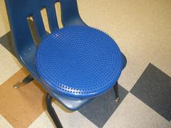
Creating a Sound Behavior Plan
Provide the child with additional resources for dealing with the stressors associated with the behavior.

Slide 38
We Would Use Visuals to Sequence a Behavioral Intervention

Slide 39
We Would Use Visuals to Teach Regulation

Slide 40
We Would Use Visuals to Teach Advocacy

Slide 41
Situation Specific Behaviors
Provide as many external cues as possible
  Example: Changes of clothing, uniform, physical parameters near desk
When you give directions include the location
“That’s not okay at school.” Give an alternative location where the behavior is okay
Make the transitions clear- Use a First-Than scenario
Be consistent
Carefully balance how many situation specific behaviors are allowed
Example: wrestling mat, marshal arts uniform

Slide 42
Understanding Your Own Scale
Changing behavior is not easy
The behavior will get worse before it gets better
Understand the trade- offs
You do not need to change everything now

Slide 43
Instructional Control
If we cannot guarantee mastery of entry level skills such as “come here”, “sit down”, “ walk with me” in our classroom, we set the student and staff up for non compliance, safety risks and behavioral escalation

Slide 44
Instructional Control: Engaging in Reinforcement
Students don’t always show interest in reinforcement
We need to use Interest Inventories in order to determine what is reinforcing
Assuming a student likes what we like is a big mistake
Pair primary or tangible reinforcement with social reinforcement such as high five or fist bumps
Delay reinforcement by using tokens or penny boards
Vary the reinforcement schedule and move from 1:1 to variable and non contingent reinforcement

Slide 45
Instructional Control: Responding to Instruction
Imitation of actions with objects, motor actions, routines.
Matching pictures and objects, identifying objects and functional pictures such as photographs and line drawings
Following one and two step directions
Understanding a picture schedule
Recognizing familiar people, classmates and teachers

Slide 46
Importance of Instructional and Natural Cues
By pairing an instructional cue with the natural cue, students can learn to complete the task with only the natural cue
Instructional cues begin with simple cues (modeling) and progress to more complex cues (multiple step directions)
Identifying and using appropriate cues is the key to consistency among staff
Moving from instructional cues to natural cues is the key to independence

Slide 47
Cues
Instructional
Cue
The instructional information provided to the student prior to the student response
An antecedent that occurs naturally in the student’s environment prior to the student response
Natural
Cue

Slide 48
Select Cue Levels
A
Modeling, “Do this” and model the action
One step direction with visual support
Multiple step direction
Naturally occring cues
B
C
D

Slide 49
During Routine Instruction: Consider the Cue Type and Pair with Natural Cue
Cue Type | Example of the Cue | Expected Student Response
A Modeling paired with the natural cue | Instructor models looking both ways, stopping at crosswalks and walking within crosswalk signs
B One step direction and visual paired with natural cue | 1.Watch the sign and provide the visual 2. Look for traffic and provide visual 3. Cross the street and provide cones along the white lines | Student looks both ways, stays within the crosswalk and crosses street when the signal indicates WALK
C Multiple step direction paired with natural cue | Watch the signal, look for traffic and then cross
D Natural cue only | Walk signs and crosswalk lines present

Slide 50
Prompting---- Independence Scoring Scale
0 Does Not Complete With Any Form of Prompting
0 1 2 3 4
4 | Independent
3 | Gesture, Visual, Verbal Prompt
2 | Intermittent Physical Assistance
1 | Continuous Physical Assistance
0 | Does Not Complete With Any Form of Prompting

Slide 51
Instructional Strategies
Ensure effective environmental supports are in place
Use the appropriate level of a reinforcement system to teach new skills or difficult steps of a routine
Provide effective prompts to the student throughout the lesson or routine… fade out prompts as the student acquires the skill
Break the individual lesson or routine steps down into small teachable steps (when needed)
Be sure the student has the prerequisite knowledge to understand the concepts needed for this routine

Slide 52
Etiologic Supports

Slide 53
Etiologic Supports
Incorporate high interest material into instruction
High interest links familiarity with novelty
Novel skill is not taught in isolation, but is embedded into the high interest material
Interest may to neutralize the full impact of learning something new ad unfamiliar, hopefully reducing anxiety
Utilize peers as teaching models. This facilitates indirect learning and reduces the intensity of the learning experience.

Slide 54
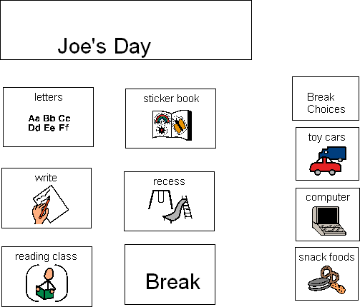
Visual supports to aid in learning
Providing choices between activities gives students a sense of control

Slide 55

Visual supports to aid in learning schedule
The question mark can be taught to signal a change in routine and schedule

Slide 56
Visual supports to aid in learning
Object schedule
Dry erase board
3-ring binder
Clip board
Manila folder
Written list schedule
Sentence schedule
Photograph schedule
Picture/Symbol schedule
Picture/Symbol with written schedule
With permission from Julie Race and Jody Minarick
Notes:
INSERT PICTURES HERE!
56

Slide 57
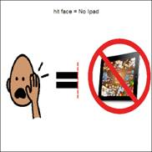

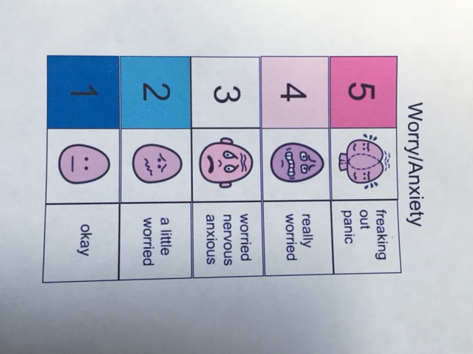

Supports to reduce anxiety

Slide 58
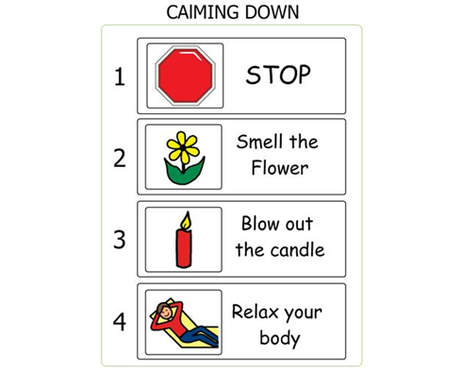
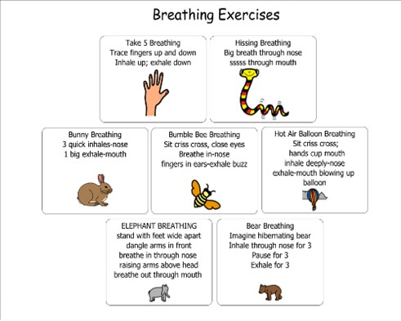
Supports for Self Regulation

Slide 59
Start with the Environment
The environment is the easiest thing to change.
The environment can have a huge impact.
Changing the environment can shed light on the true antecedent of behaviors.
The environment is anything physical.
The physical structure of the environment should not be overlooked as fundamental to basic visual supports

Slide 60
Environmental Supports and Classroom Set Up
Setting Up A Classroom Questions to Answer
1. Is there a place to implement DT’s?
2. Is there a place to play that includes structure for PRT?
3. Is there a teacher table?
4. Is there a place for circle time/morning meeting?
5. Is there a place for group lessons?
6. Is there a place to practice restroom routines
7. Is there a place to set up independent learning for towers and listening?

Slide 61
Structured Teaching and Errorless Learning
Do not allow your child/student to make mistakes as they begin to learn words
  guide your child’s/student’s hand so they always make a correct match
  adjust the difficulty level of a task to be sure your child/student is successful
Ensures initial success which leads to greater feelings of competence and motivation

Slide 62
Environmental Supports and Structured Teaching
Structured teaching provides predictability and sameness which is calming and stabilizing to students who are anxious.
Clearly defined expectations, assignments and time lines are comforting and allow the student who is anxious to access potential
Structured teaching provides concrete parameters and physical organization of the learning environment

Slide 63
Environmental Supports and Structured Teaching
Structured Teaching uses gestalt staging. This is consistent with seeing the whole and not the parts. Students with cognitive delays often require a concrete presentation
Non sequential learners can benefit from a global visual picture which includes the “whole” of what is expected
Structured Teaching provides the entire sequence of a task so that the student can see the end to better define the completion and steps to get there
Systematically teaches flexibility in responding, helping the student to adapt to new situations

Slide 64
Environmental Supports and Structured Teaching
Provides specific guidelines and expectations to promote the development of independence and task completion
Provides limited input, applying reduced verbal input with visual supports. Helps the student focus on the concept and not the details.
Token boards, visual incentives, and point charts build attention and provide concrete evidence of how long the task will take and when they will gain the reinforcement

Slide 65
Environmental Supports and Structured Teaching
Knowing the learning style enables us to provide targeted academic intervention.
Visual learner
Reading programs that incorporate visual methodology
Logo Reading
Word Builder
Edmark Reading

Slide 66
Suggested Reading Programs
Logo Reading- Braden
Logo Reading App- Apple Store
Word Builder- Braden
Joan Green Interactive Reading- Grenhouse Publishing
Edmark Reading Program- Pro Ed Inc
Essential Sight Word Reading Program- Wieser Educational
Read Naturally- read naturally inc
Fundations
OSMO Learning-Play Osmo.com

Slide 67

Logo Reading mobile application for I-phones and I-pads

Slide 68
Suggested Math Programs
Math Equivalence Board- Braden
Math Triumphs- McGraw-Hill
Touch Math- touchmath.com
Coinulator and worksheets- difflearn.com
Joan Green math book- Greenhouse Publishing
Make it in no time- autismtasks.com

Slide 69
Inclusion in the Classroom, Community
Steps to Successful Inclusion STSI
History behind STSI
If the student is included during the school day what does he/she miss in SPED setting?
Identify the outcome and reflect it in IEP goals
social, behavioral, academic?
Use probe data to determine efficacy

Slide 70
Inclusion in the Classroom, Community and Work Environments
Steps to Successful Inclusion
Started with the STAR (Strategies for Teaching Based on Autism Research) curriculum data sheets for functional routines
Bathroom
Specials (art, music and PE)
Small group
Teacher table
Lunch

Slide 71
Inclusion in the Classroom, Community and Work Environments
Determine the Outcome- Inclusion Should be Purposeful
  Social
  Behavior
  Following Classroom Routine
  Language- spontaneous communication
  Academic
  Vocational

Slide 72
Example STSI data sheet for Following Classroom Routine
Cue | Response | Date Data code
Schedule indicates X | Student goes to designated area in classroom and waits
Classroom teacher gives instruction | Student attends to classroom teacher
Academic materials are required | Student gets required materials
Classroom teacher gives assignment | Student works on assignment appropriately
Classroom teacher is available | Student asks for help in an appropriate way if needed
Classroom teacher indicates X is over | Student moves/transitions from the activity
Data codes NA 0= No response 1= Physical prompts for almost all
2= Physical prompt for part 3= Verbal or gestural 4= No additional prompts

Slide 73
Inclusion in the Classroom, Community and Work Environment
Steps to Successful Inclusion
The structure is first established in the special education setting
The instructional supports are provided and taught in a SPED setting
As the student becomes more independent and needs less instructional support based on the probe data, the structured supports became essential.
The structure and visual supports are adapted to be used in the general education setting

Slide 74
Inclusion in the Classroom, Community and Work Environments
Steps to Successful Inclusion
As the student becomes integrated into the general education setting, the natural supports provided by the classroom teacher are utilized.
Those natural supports are surveyed by the SPED teacher to determine if additional supports are necessary

