Slide 1
Enrich Reminders!!!!!
You can always get 1-1 Training with your Records Clerk!!!!!

Slide 2

Enrich Blue Men (do not exist)
Notes:
I envision little elves to help us write our IEP’s!!!! Maybe some day!

Slide 3
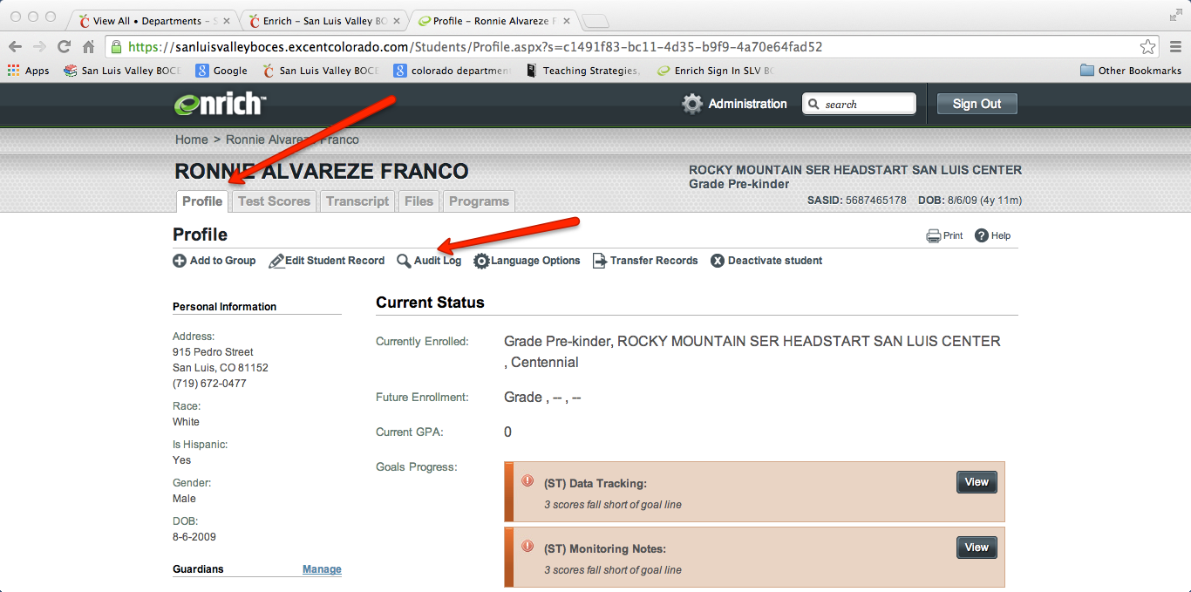
Documenting Access to IEP on Enrich
A new process!!!
Notes:
Go to profile tab, go to (there are 2 slides) We are going paperless and preparing!!!!!

Slide 4
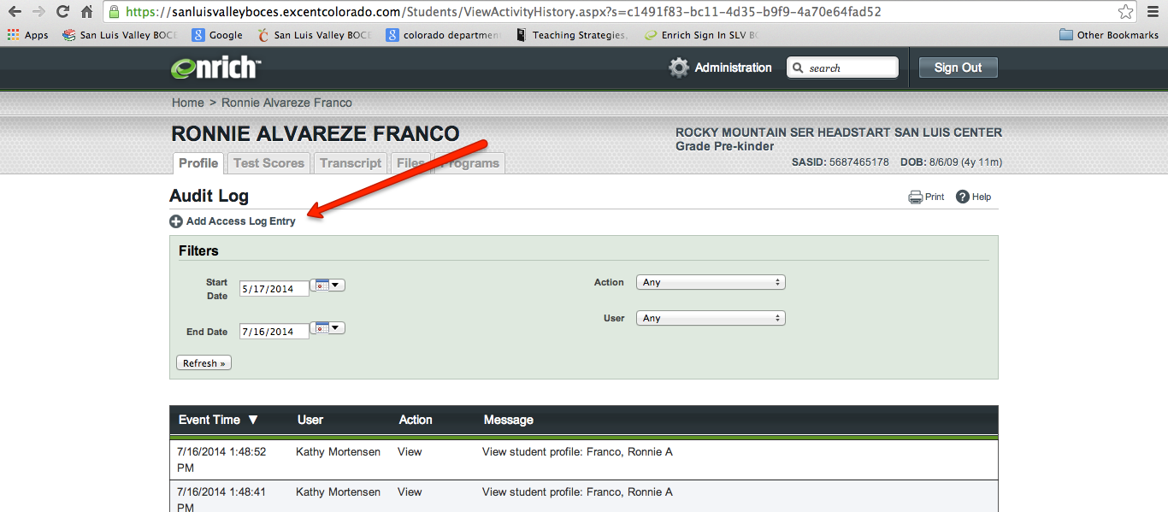
Documenting access to IEP on Enrich
Notes:
Document your access

Slide 5

Validating,Finalizing and Admin Approval
Notes:
All forms must be admin approved, IEP amendments, special requests, evaluations, special evaluations, consents, There is a song “clean up.....” We all need to help clean up Enrich by informing records when every action is complete!!!

Slide 6
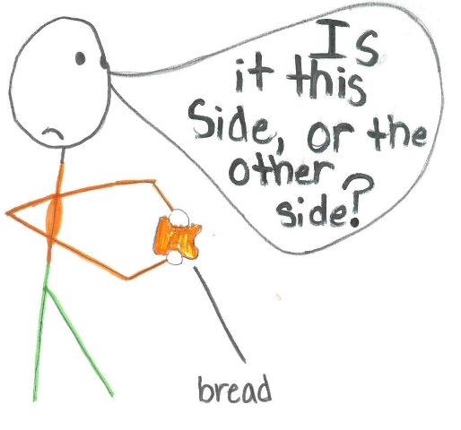
Special Request and IEP amendment
Notes:
IEP amendment requires parent signature. Go through step by step IEP amendment and Special Request. NO PWN in amendment, Yes PWN in spec request, NO notice in amendment, NOTICE in special request,
My language for ECSE got in the way and there was a gap in what I said and what I had in my mind.....gap analysis pays off.......

Slide 7

Evaluation Sequence for Forms

Slide 8

Special Evaluation

Slide 9
Notice of Meeting/Excusal
Complete excusal before IEP meeting.
Mark parents or related service staff as absent. Others don’t need to be marked absent as they will generate an excusal.
Some automatic generation of sped director in notice of meeting

Slide 10
Transfer of students within the San Luis Valley
Contact your records specialist. Enrich now allows us to transfer
Review the IEP, as when this transfer happens, you are accepting the IEP as written.

Slide 11
Text Assist
In a few circumstances: PSG for Transition to Adulthood, Course of Study, Transition Services.
PWN for change of placement or LRE at an annual

Slide 12
Updates
Automatic generation of forms after eval, eligibility
Chevron will go away some day
Times a year for goals taken out

Slide 13

Other Questions I can’t answer for you????????

