Slide 1
Functional Behavior Assessments
April 12, 2019
Marcia L. Braden, Ph.D., P.C.
www.marciabraden.com

Slide 2

Workshop Schedule
8:00 Sign in- Coffee/Announcements
8:15 Introductions and Experience with FBA’s
8:45 -9:30 Foundations for Intervention Strategies
9:30 -10:30 What is an FBA ?
10:30-10:45 Break
10:45 -12:00 What is the Function and Why Is It So Important?
12:00-1:00 Lunch on your own
1:00 -2:00 Video Analysis and Case Studies
2:00-2:45 Behavioral Tools and Data Collection
2:45-3:00 Break
3:00-4:00 Continue Behavioral Tools and Questions

Slide 3

Why Are We Here?
To provide consistency for supporting students with behavioral needs through a defined documentation and procedural process.
To support behavioral goals through the MTSS process, and/or students with disabilities.
To provide practical training on FBA methods and tools.
To prevent problem behaviors from occurring.
To teach alternative behaviors
To effectively respond when problem behaviors occur.

Slide 4
We All See Things Differently
What behavior would you choose to target?
(video)

Slide 5
What Behavior Should Be Targeted?
Attending to task at the computer
Sensory dysregulation (chewing his shirt, hand flapping, sucking thumb)
Social awareness

Slide 6
Foundations for Intervention Strategies

Slide 7
Case Study
Illustration
For example, perhaps the student has a hard time showing his work on math problems. In math class, he gets angry, crumples up the paper and is disruptive. He’s sent to the principal’s office.
The behavior isn’t appropriate, but it served its purpose. Your child managed to avoid doing the work that was frustrating him. He may not know that was his goal, but he found a way to deal with the math that was causing him stress.

Slide 8

A functional behavior assessment is an approach to figuring out why the student acts a certain way. It uses a variety of techniques to understand what’s behind inappropriate behaviors. This includes looking at non-academic factors that might be contributing to the student’s frustration with learning.
What is a Functional Behavior Assessment?

Slide 9

Knowing what’s behind inappropriate behavior can help you and the school find ways to change the behavior. The basic idea behind this approach is that your student’s behavior serves a purpose. Whether he’s aware of it or not, your student acts a certain way to get to a desired outcome or goal.
What is a Functional Behavior Assessment?

Slide 10

A key part of a functional assessment is figuring out what triggers certain behaviors in your student at home, in school and with friends. Sometimes parents and teachers assume they know what’s causing a child’s behavior because they’ve seen other children do similar things. But it’s important to remember that the causes for the same behavior can vary widely among children.
What is a Functional Behavior Assessment?

Slide 11
The Same Behavior with Different Functions
Running
Runs away but always goes to the kitchen location
Susie A
Runs away but looks back at the adults and laughs
Susie B
Runs from the facility and ends up in a variety of locations
Susie C

Slide 12
Functions that Behaviors Serve

Slide 13

Practical FBA Assessment vs. Comprehensive FBA Assessment
A functional assessment has a narrower focus than a comprehensive evaluation. It focuses on the why, how, where, when and what of your child’s behavior.
A comprehensive evaluation is a process that’s used to see if your child is eligible for special education services. It looks at all aspects of your child’s learning. If behavior is a concern, a functional assessment may be part of the comprehensive evaluation process

Slide 14
Practical FBA vs
Comprehensive FBA
 | Practical FBA | Comprehensive FBA
For: | Students with mild to moderate problem behaviors (behaviors that are NOT dangerous or occurring in many settings) | Students with moderate to severe behavioral problems; may be dangerous and/or occurring in many settings
What: | Relatively simple and efficient process to guide behavior support planning | Time-intensive process that also involves archival records review, family-centered planning, and collaboration with agencies outside of school
Conducted by whom: | School-based personnel (e.g., teachers, counselors, administrators, MTSS team members) | Behavior Support Team (e.g., school psychologists, behavior specialists)

Slide 15
Practical FBA’s
Observation format
No need to get permission to assess
Requires fewer people on the team
Requires no formal assessments
Uses universal supports with some adaptations

Slide 18
STSI
Scoring and Reporting Results
This observation format enables the team to compare the target student with others in the classroom setting.
The data is taken with specific outcomes in mind such as social behavior, learning behavior, aberrant behaviors such as talking out, distractibility, work completion issues, etc.
The data tells the team how the target student is different from his peers and what level of prompting is necessary to bring him success in the classroom.
When you add the number of “4’s” at the bottom out of the number of observations, you can determine the level of independence demonstrated in the classroom.

Slide 19

The Comprehensive FBA Assessment Team
Assessment is a team effort. Each team member sees your student from a different perspective. Everyone works together to figure out what’s going on with your child’s behavior.
The assessment team varies from school to school. It typically includes a person with specialized training, such as a school psychologist or behavior specialist. That professional helps to gather information. She/He interviews people who know and work with the student. She/He will also speak to the student and do some screenings or assessments

Slide 20
Requesting a Practical FBA
Complete
Teachers & school teams can complete a Request for Assistance form to refer a student for a Practical FBA
Talk
Talk to school on obtaining parent permission to conduct a Practical FBA with a student
Request
Request for Assistance should give a broad picture of the student and their behaviors

Slide 21
Steps to Performing a Meaningful FBA
Step #1: Defining the inappropriate behavior
Using vague words to describe your child’s behavior can make it harder to gather the best information. Saying that your child is “disruptive” doesn’t give enough information.
Each one of us has definition for being disruptive- brainstorm definitions with the group

Slide 22
Steps to Performing A Meaningful FBA
Step #2: Collecting, comparing and analyzing information.
Team members work to pull together information from the student records, interviews and questionnaires. Their goal is to answer questions like:
Where is this behavior happening?
Where is it not happening?
How often is the behavior occurring?
Who is around when it occurs?
What tends to happen right before and right after the behavior?
What is a more acceptable behavior that can be used as a replacement?

Slide 23

Collecting, Comparing and Analyzing Information, Comparing and Analyzing Comparing
Team members work to pull together information from the student records, interviews and questionnaires. Their goal is to answer questions like:
Where is this behavior happening?
Where is it not happening?
How often is the behavior occurring?
Who is around when it occurs?
What tends to happen right before and right after the behavior?
What is a more acceptable behavior that can be used as a replacement?

Slide 24
Collecting, Comparing and Analyzing Information, Comparing and Analyzing Comparing
FUNCTIONAL ASSESSMENT SCREENING TOOL (FAST) adapt-fl.com/files/FAST.pdf
Formal and informal interviews
Motivation Assessment Mark Durand and Daniel Crimmins
Functional Assessment and Intervention Team Meeting Record
Scott, Liaupsin and Nelson 2002
Functional Assessment Checklist for Teachers and Staff (FACTS A&B)
March, Horner, Lewis-Palmer, Brown, Crone, Todd and Carr, 2000

Slide 25
Most Common Data Collection Strategies
Frequency: A count of how many times the behavior is observed
Rate: A measure of how many times the behavior was observed across some span of time like 60 times in an hour or an average rate of once per minute
Percent correct: How many times did the student perform the skill accurately per some number of opportunities.
Duration: How long did the behavior last from beginning to end?
Latency: How long did it take for the behavior to begin once some trigger stimulus was present?
Magnitude: Some measure of intensity or level of the behavior, often expressed on some sort of scale.

Slide 26
Behavior(s) to be Targeted
Video Exercise
What is the setting?
What is the targeted behavior?
How is the behavior reinforced?
(videos)

Slide 27
Steps to Performing a Meaningful FBA
An ABC chart is a tool that’s frequently used in this step.
A stands for Antecedent (what happens before),
B is for Behavior (the action or reaction), and
C is for Consequence (what happens after).

Slide 28
Antecedents
Physiological
Environmental
Curricular Expectations
Social

Slide 29

Physiological Antecedents
Red ears, face or neck
Elevated heart rate,increase in perspiration
Rapid speech which gets louder and cluttered
Hand flapping or other stereotypies
Hyperactivity
Physically ill

Slide 30
Environmental Antecedents
Loud and unfamiliar sounds
Transitions and changes in routine
Crowded conditions
Artificial lighting or blinking lights
Novel experiences
Intense sensory input

Slide 31
Crowded and
Noisy Places/Transitions
Large noisy areas with many children can be over stimulating. Structure and space allotment makes the environment more tolerable.
Some students have behavioral episodes because changing an environment is difficult. They are unsure of the expectation in different environments and with different staff. They often need a job or a transitional object in order to ease the anxiety connected with the transition.

Slide 32
Curricular Antecedents
Students often want to appear as normal as their typical peers
Highlighting their weaknesses by exposing their delays can provoke a behavioral reaction
Curricular adaptations allow the student with FXS to participate without feeling stressed by unrealistic expectations

Slide 33
Social Antecedents
Typical defenses to being overstimulated include: dropping to the floor, hiding behind a parent, chewing and mouthing objects and hiding behind hands

Slide 34

Functional Behavior Assessment
Step #3: Hypothesizing reasons for the behavior.
A hypothesis is a best guess based on the information you have. The team works together to figure out what your child’s behavior is telling them. What does he get out of ripping up his paper and being disruptive? It’s the team’s job to figure out what he is escaping, avoiding or getting from the behavior.

Slide 35
Defining Observable Problem Behaviors
Definitions of behaviors need to be:
  Observable: The behavior is an action that can be seen.
  Measurable: The behavior can be counted or timed.
  Defined so clearly that a person unfamiliar with the student could recognize the behavior without any doubts!

Slide 36
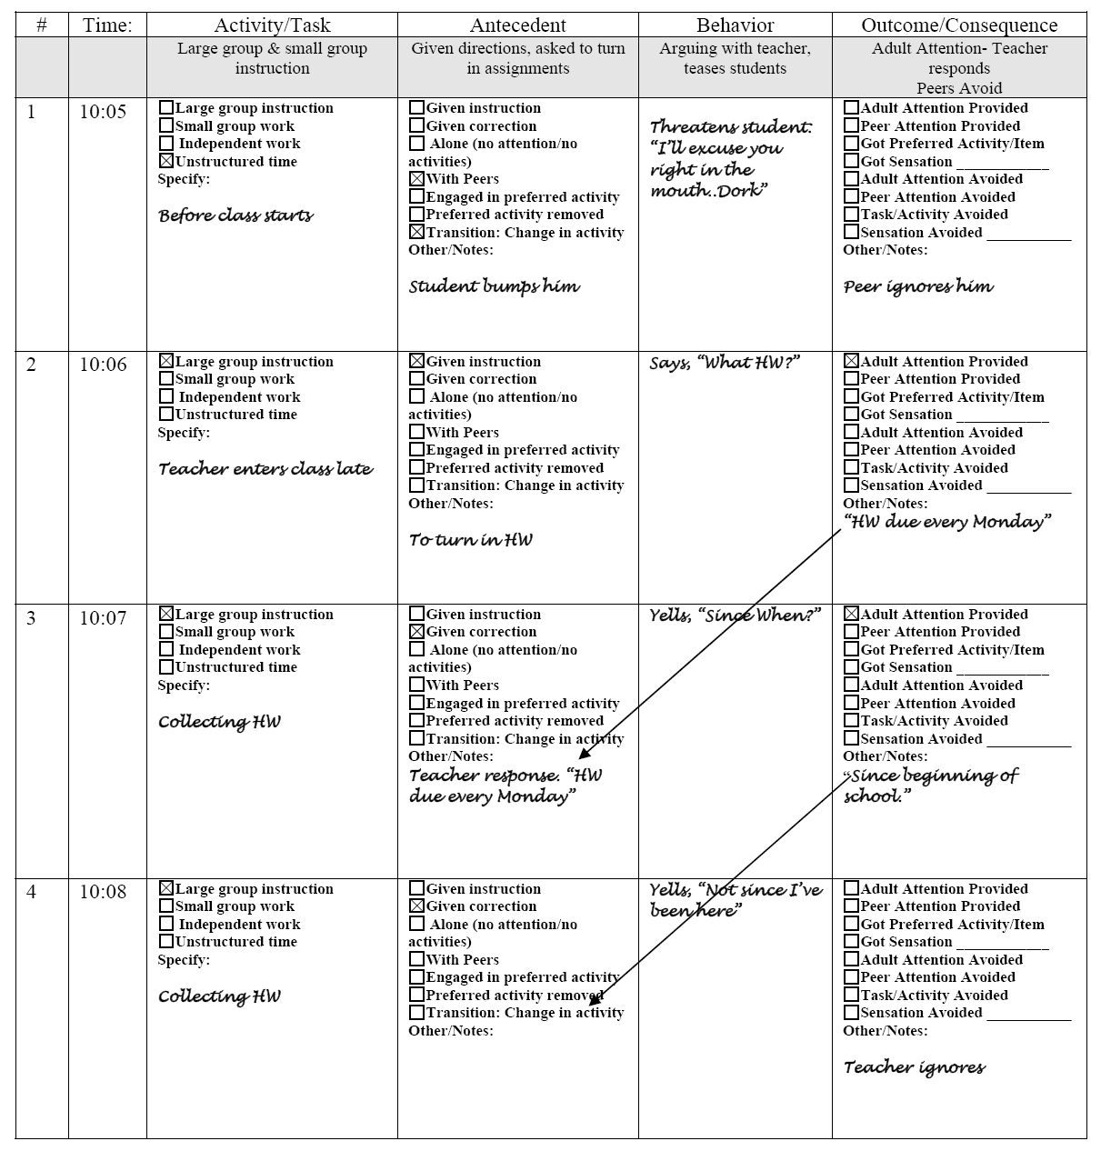

Slide 37
Descriptive Data Sheet
Date/Initials of Recorder | Time Of Day | Frequency/ Duration of Behavior | Setting/ Specific Room | Antecedent (Before Behavior) Circle One | Topography (Behavior- What Does student Do?) | Consequence (After Behavior- What Occurs After Behavior?) | Return to Original Activity? Yes/No
 |  |  |  | No Attention Demand Denied access to item/act Alone Explain:_______________ ______________________ ______________________ ______________________ | This is where you list behaviors | Examples here, but you can add your own Verbal Reprimand Intentional Redirection No Attention Remove task/act Provide access to item/act Other Distractions Sensory Activity Follow Through with Request Verbal Praise/Social Reinforcement

Slide 38
Behavioral Descriptors
At the bottom of the data sheet, we operationalize the behavior. Explain a behavior such as Hitting: Any use of his hands to strike out and touch another person with impact. Eloping: Leaving or attempting to leave (walking or running) an activity or setting in which he is engaged or has been instructed to stay. Grabbing: Any extension of the hand or arm in the direction of an object or person accompanied by wrapping or attempting to wrap his fingers around that object or person. May but does not have to, be accompanied by squeezing of the object or person. Negative behaviors during transitions: any hitting, running, pinching or climbing while in transition from one person or location to another.

Slide 39
Practice
(videos)

Slide 40
Practice Assessment
Latency in getting started- strategy to get him started
Antecedent strategy to encourage him to make a choice
What does regarding choices when she is asking for #3?
Voice and volume variation – does he like it?
What is antecedent for SIB?
What antecedent strategy did she use right before asking him to place #6 on the second strip? Physical prompt
Working for bubbles paired with social praise

Slide 41
Case Study #1
Behavioral Detectives: A Staff Training Exercise Book in Applied Behavior Analysis
Bobby Newman, Ph.D., B.C.B.A. and Dana R. Reinecke, Ph.D., B.C.B.A.
Nancy was enrolled in preschool for children who were both typically developing and those diagnosed with developmental disabilities. When I arrived to observe at the program, I was informed by staff that aggression toward staff members had been escalating over the past several months. Nancy generally engaged in aggression by slapping out at staff members with a flat palm. The most common target of the aggression was Nancy’s 1-to-1 aide, who was assigned to her both for behavior management and for adapting activities to her particular needs.
A treatment plan had been put into place approximately six weeks earlier by the school psychologist attached to the program. The plan was based upon a meeting that had been held with relevant staff. No systemic functional analysis nor A -> B -> C data (information about behavior, what happened before, and what happened after it occurred) had been collected prior to the meeting, so the discussion consisted of interpretations of staff as they thought back on particular instances of Nancy’s behavior.
Staff expressed that the behavior was displayed across a variety of conditions, and for a variety of reasons. No clear function for the behavior had been determined. Staff decided to put a token economy system into place to discourage the slapping. The token economy consisted of the following:

Slide 42
Case Study #1 Continued
A token board with 25 tokens already on it would be given to Nancy.
If Nancy slapped at a staff member, a token was removed from the board (a response cost procedure).
If there were any tokens left on the board at the end of each three-hour interval, Nancy would be allowed to choose a reinforcer from a menu of reinforcers.
If Nancy did slap at a staff member, the staff member would say “no slapping.” The activity was not terminated unless aggression escalated to the point where staff felt that Nancy needed to be removed from the group to calm down.
During the first observation, slapping was displayed at a very high rate. Nancy earned a reinforcer (she chose computer time) during the first three-hour interval of the day, but did not earn a reinforcer during the second three-hour interval. In fact, Nancy lost all her tokens within the first hour of the second three-hour block. Behavior continued to escalate for the remainder of the day. On subsequent days, she rarely earned any reinforcement, until we adjusted the treatment plan.

Slide 43
Case Study #2 and Discussion
Jim was participating in a home program, and a very well-designed one at that. Programming was intensive and followed an excellent sequence. Staff were well-trained, and members of the family all were highly knowledgeable about current programming steps. The increase in hitting had prompted the head programmer to suggest that they put a DRO program into place. For ten minute periods that did not include any such aggression, a letter would be added to his token board. When Jim had spelled out “I earned computer,” he would be able to go use the computer for ten minutes. The failure of the program was somewhat mysterious. Jim had used token economies in the past, and they had been effective motivators as he had transitioned from primary to conditioned and then generalized reinforcers. The activity reinforcer also did not seem to be the issue. All agreed that Jim found the computer reinforcing. It had been used in this capacity in the past. He happily spent time on the computer when not in session. To date, however, the DRO program within session had not been remarkably effective in reducing the competing behavior. Hitting was still occurring, and this was obviously interfering with the learning process.

Slide 44
Case Study #3
In our next scenario, we find ourselves in that tight spot when a treatment plan has been put into place, but the data aren’t showing a change in the desired direction. When such things happen, the two most obvious factors to check are:
Is this the right plan (i.e., have we done our functional analysis/assessment well)?
If this is the right plan, is everyone carrying it out correctly?
Just to give a hint, it turns out neither of these common and obvious reasons was valid. Let us once again forge ahead.
Melissa was a young girl diagnosed with moderate mental retardation. She was doing well within her program, but progress was being impeded by frequent bouts of noise-making. According to the paperwork I inherited, Melissa would make silly noises or begin to sing, at seemingly random intervals. Unable to identify a clear function for the behavior, the staff had put a Differential Reinforcement of Other behavior (DRO) plan into place to try to give Melissa an incentive to refrain from the behavior.

Slide 45
Case Study #3 continued
As I observed the plan in action, the failure to show improvement was not immediately obvious. Melissa’s staff were very diligent in carrying out the DRO plan. Every minute on the minute, if she refrained from engaging in the noise-making, a reinforcer was delivered. Melissa always reached for and accepted the reinforcer, indicating that the reinforcers were probably motivating. An informal “eyeballing” of the situation seemed to indicate that the behavior was decreasing.
The graph doesn’t lie, however, despite my subjective impressions. Staff were keeping very careful partial-interval recording data. Looking at the graph, 100% of the 30-minute intervals showed at least one inappropriate noise emitted by Melissa.
Discussion

Slide 46
Developing A Behavior Plan
Once the team has an idea of the reasons behind your child’s inappropriate behavior, the team works closely with the behavior specialist or psychologist to find ways to see if the hypothesis is right. This means changing something in the environment to see if it changes the behavior.
To do this, they create a behavior intervention plan (BIP). A BIP is a plan that’s designed to teach and reward positive behaviors. This can help prevent or stop problem behaviors in school.

Slide 48
Hypothesis/Summary statements
A statement of student behavior that provides a hypothesis of the:
    Operational definition of problem behavior
    Antecedent variables that trigger the problem behavior
    Functions maintaining the problem behavior
        e.g., Get/Avoid Attention/Activity
Accuracy of summary statements will provide a metric for the efficacy of the FBA

Slide 51
Questions and Further Discussion

