Slide 1
IEP and Frontline Updates
Presented by: Nita McAuliffe and LJ Garcia

Slide 2

Topics for the day:
RDA Overview
IEP Procedural Guidance: Exceptional Student Service Unit Technical Assistance
IEP Planning
File Review Reminders
Frontline Updates
Website Updates and Resources
Questions and answer

Slide 3

RDA (Results Driven Accountability)

Slide 4
Why?
The principal guiding revisions to accountability
Focus on what will most likely impact and improve educational results and functional outcomes for students
The assumption is that states have compliance mastered. There are 755 items to assure in IDEA. This will not go away.
San Luis Valley BOCES has Met Determination for the past four years.

Slide 5
What?
Compliance Indicators
Disproportionate Representation (San Luis Valley has no disproportionality at this time)
Timely Initial Evaluation (95%)
Early Childhood Transition (100%)
Secondary Transition Compliance Findings (100%)
Timely and Accurate Data (Yes)
Results Indicators
Graduation Rate
Drop-Out Rate
Statewide Assessment
Suspension and Expulsion
Educational Environment
Preschool Environment
Parent Involvement
Postsecondary Outcomes
Resolution Session Agreements
Mediation Agreements

Slide 6
Impact on us?
Compliance will never go away!!!
Our AU Determination will be based on:
State Assessments
  Math and ELA Participation (all points about 95%)
  Math and Reading performance on statewide assessments, mean scale score (o)
  Preschool Achievement and Growth
Academic Points (8.5 out of 45)

Slide 7
Impact on us?
Academic Growth Points
Includes Math and ELA (85 out of 150)- Rise up and Keep up
PS and Workforce (64 out of 105)- Graduation rate, dropout, outcomes for graduates
Combine compliance and results for final determination.

Slide 8
Impact on us?
Our challenge is to
balance the continued
pressure of compliance
with high expectations of results and outcomes for
students.

Slide 9
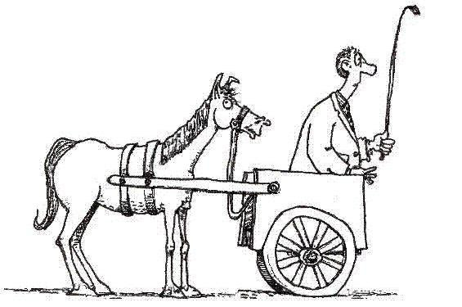
IEP Manual: Reminders

Slide 10
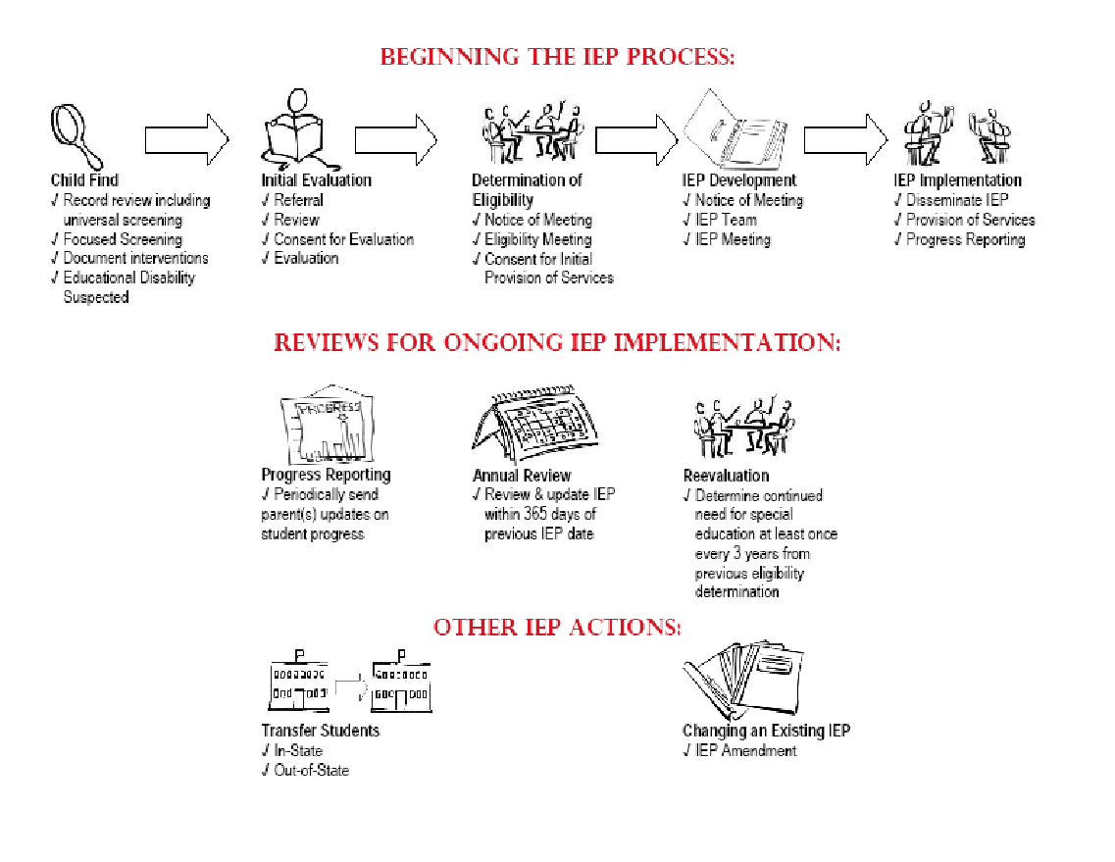
Notes:
10 Min.
Provide overview of the process (10 minutes)
Tool you can use as you train other audiences

Slide 11
IEP Meeting participants
IEP Team Participants:
  Parent
  Student (if appropriate or 15+)
  General Education Teacher of the student*
  Special Education Teacher
  Special Education Director or Designee (can not be excused from the meeting)
*If the student is or may be participating in the general education classroom
Notes:
10 Min. to get through slide 29 (Excusal)
General Education Teacher must be a teacher of the student. If the student is not currently participating in a general education classroom but will be, a teacher of students of the same age can be the teacher
NOTE: Special Education Director or Designee
IDEA requires participation of a representative of the public agency who –
Is qualified to provide, or supervise the provision of, specially designed instruction to meet the unique needs of children with disabilities;
Is knowledgeable about the general education curriculum; and
Is knowledgeable about the availability of resources of the public agency [and has authority to commit resources]
PER ECEA, this individual CANNOT be excused from the meeting

Slide 12

Procedural Safeguards http://www.cde.state.co.us/spedlaw/download/2011ProceduralSafeguards.pdf
On these occasions:
  Initial permission to evaluate
  Due Process is requested
  Disciplinary change in placement
  Upon request
  AND once per school year A copy of the procedural safeguards must be given to the parent of a student with a disability one time per school year. During the IEP conference, the parent should check the “yes” box on the IEP form and sign the provided line to indicate that the parent was given a copy of the Procedural Safeguards or enter the date within the current school year when the parent was provided a copy of the Procedural Safeguards. Another copy of the Procedural Safeguards should be given to the parents at the IEP meeting if requested.
Notes:
WE are at 99% compliance with this! How do you document this when a parent is NOT in attendance at an annual or triennial? 7 out of 84 IEP reviews did not contain evidence of parents being provided procedural safeguards on an annual basis.

Slide 13
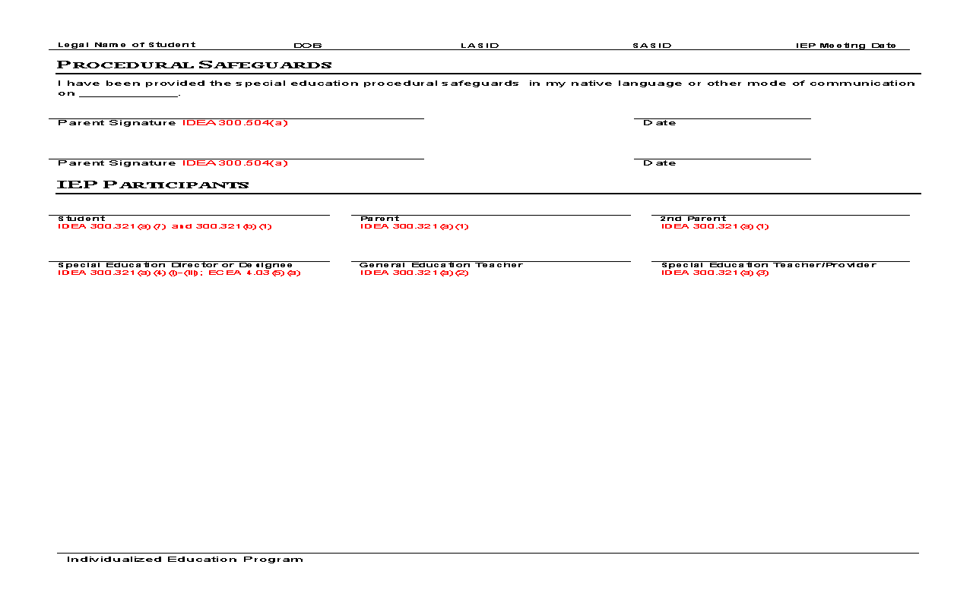
Procedural Safeguards

Slide 14
Procedural Safeguards
Key points to cover:
parent access to student records,
parent rights to ask that those records be amended,
parent rights to participate in groups and meetings where decisions are made about their child’s education,
parent notification requirements (prior written notice and the procedural safeguards notice), and
selected other safeguards (e.g., independent educational evaluation, surrogate parents, age of majority).

Slide 15
IEP team
Parent partnerships
Student (if 15 or older)
Multidisciplinary Team:
  Parent
  Student (if appropriate)
  At least 1 teacher or specialist with knowledge in suspected area of disability
  As necessary: other qualified professionals such
  as OT/PT, SLP, school psych, RN

Slide 16
IEP evaluation
Consider strengths and needs, as well as concerns about the student
Identify data Team already has, and data needed to determine eligibility
Prior Written Notice & Consent for Evaluation
Notes:
Focused evaluation that is sufficient to identify the needs of the student, no longer required to engage in a comprehensive evaluation in all domains
Team challenge to consider the individual student in planning evaluation
Note that hearing and vision screening is required under CRS for students in grades K, 1, 2, 3, 5, 7, 9; if the student is in a grade other than one for which screening is required, the team may determine that hearing and/or vision screening may be necessary as part of the evaluation process . To Kathy M should be part of ANY c to b (in person or file review), any preschool B.
Spirit of PWN: Parents understand what is happening, are engaged and involved and if necessary can access dispute resolution
Not to be confused with notice of meeting, which has its own requirements.
What issues have come up with evaluation? C to B: lack of connection to vision specialist;

Slide 17
PLAAFP
Data in PLAAFP suggests need(s) – get away from stating “See attached”
Statement of the child’s present levels of academic achievement and functional performance – compliance vs. quality (Appendix D – Pg. 135)
Statement about progress on goals and post secondary goals for Transition IEP’s

Slide 18
Annual Goals-Alignment
Measurable goal should align directly to PLAAFP
Prioritize & consolidate goals as appropriate
Standard(s) reflected after goal
Unit of measurement (criteria) relate to skill being taught (SMART goals)
Notes:
30 Min. to get through slide 43 (Goals now)
Sybil’s need: reference evaluation report
PLAAFP= Present Levels of Academic Achievement and Functional Performance
Clarify that data reported in PLAAFP indicates needs and that these should be reflected in annual goals; provide a common thread
Goals are not standards but should be related to the student meeting benchmarks indicated by standards
Measures should be directly related to skills and may be percentages, number of demonstrations related to number of opportunities, etc.
Brainstorm for skills: how will they be measured
Skill: reading comprehension (percentage correct)
Skill: task completion (number of assignments completed of number of assignments given)
Skill: social initiation with peers (appropriate initiations within a period of time)
Skill: eliminate aggression toward peers

Slide 19
Annual Goals-objectives
Objectives:
Only required for students taking state
alternate assessment(s)

Slide 20
Goals
SMART Goal Criteria
Specific
Measurable
Achievable
Reasonable
Timeline
Notes:
Get out of Jail Free Card: 84 IEP reviews, only 6 IEP’s did not have smart goals! That is 1%. 99% are SMART!
SMART Criteria
What does it mean to be SMART and avoid special ed jail in writing annual goals?
Specific
Measurable
Achievable
Reasonable
Timeline

Slide 21
Goals (cont.)
Make sure we are aligning goals to standards.
If we forget to align one goal, it will not meet compliance
Every discipline needs to be doing this
Examples: Appendix d – Pg. 12
CDE quotation “It is denial of FAPE if not making growth on annual goals year after year”. (year after year with same goal and lack of progress).
For Transition to Adulthood Focus on skills to be in place 12-24 months AFTER graduation.

Slide 22
Goals (cont.)
Compliance
~Anthony will improve his writing skills as demonstrated by scoring proficient or above on the writing rubric.
Quality
~Across all academic settings, Anthony will independently follow the 3rd Grade Writing Rubric for Organization (creating a plan for his writing, writing a topic sentence and detailed closing sentence); and Word Choice (using descriptive adjectives, adverbs, and verbs) by scoring Proficient or above (Strong Performance).
Reading

Slide 23
Goals (cont.)
Compliance
~Conrad will solve multi-step math problems with 80% accuracy.
Quality
~During daily independent activities, Conrad will solve multi-step problems with whole numbers and fractions using a variety of strategies and answering questions with 80% accuracy as measured by a classroom probe administered 3 times per IEP period.

Slide 24
Progress Reporting
Must report about the student’s progress toward achieving the annual goal
Include supporting data (e.g. graphs)
Completed as often as general education report cards
Notes:
26% of IEP’s reviewed last year did not have progress reports OR 22 out of 84 IEP’s reviewed did not have progress reports.
SLP team to complete progress reports on SEAS beginning 2011-2012 school year.

Slide 25
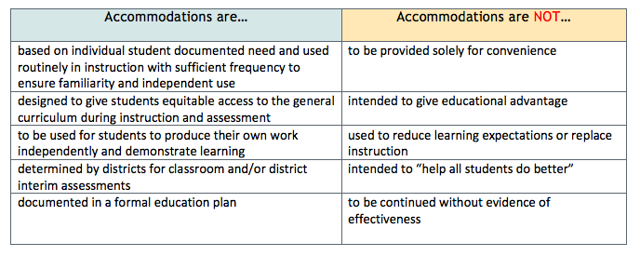
Accommodations

Slide 26
Modifications
Modifications are typically utilized for those students who are supported through Extended Services
We are making modifications to the standards so that the child can access the general curriculum
Resource students typically do not need any curricular modifications

Slide 27
New IEP Manual: Completing the IEP Form
Review as a group pages 56-78
Make note of Appendix D (p. 128) for Guidelines to Improve IEP Quality
Resource is on CDE’s website as well as at www.slvboces.org under Departments (Exceptional Student Services)

Slide 28
File Review Reminders
Statement of the child’s present levels of academic achievement and functional performance – compliance vs. quality
Statement about progress on goals and post secondary goals for Transition IEP’s
Concerns of the parent (remember this is not always negative) – link to PWN
Goals are measurable, reflected in present levels and aligned to standards
Statement describing whether the child will achieve local or individualized standards
Child is removed from regular education environment only when the nature or severity of the disability cannot be achieved satisfactorily even with supplementary aids and services
Notes:
Use dedacted file

Slide 29
Frontline Updates
Topics:
Special Request evaluations do not exist unless it is connected to an FBA- This is why evaluation planning becomes so important.
If an IEP amendment takes place always go through an Add Action IEP Amendment
Goals are aligned to standards and updated yearly
Progress Monitoring – switch from Trimester to Quarterly
Change of Status
Indicator 13 Tips

Slide 30
Forms to be uploaded due to signatures
Permission for evaluation
Initial consent of Services
Amendment
Attendance at IEP meeting (parent also signs they received rights)
Eligibility determination disability pages

Slide 31
Frontline Tips
Dashboard
Batch printing
Help Tips
Probe Scoring
Audit logs
Tips: Administrator use can see who has accessed a student at anytime. If a student moves please turn in change of status.

Slide 32
File Reviews
Review Standard Checklist for File Reviews to State

Slide 33
Web Site Resources
Tour of www.slvboces.org
Indicator 13 Tips Manual
Related Services Providers

Slide 34
Parent Survey
Requirements/Information about Parent Surveys
Responsibilities of Case Managers

Slide 35

Question and Answer
Getting our ducks in a row!

