Slide 1
SPED 101 and Frontline Updates
Presented by: Nita McAuliffe and LJ Garcia

Slide 2
Topics for the day:
SPED 101
Enrich Updates
Website Updates and Resources
Questions and Answer

Slide 3
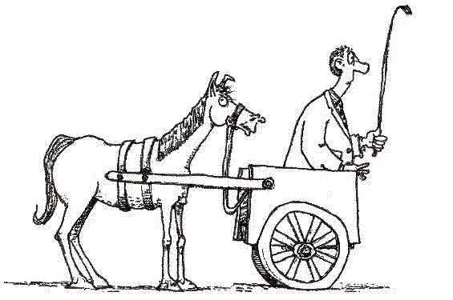
IEP’s - Where do we begin?

Slide 5
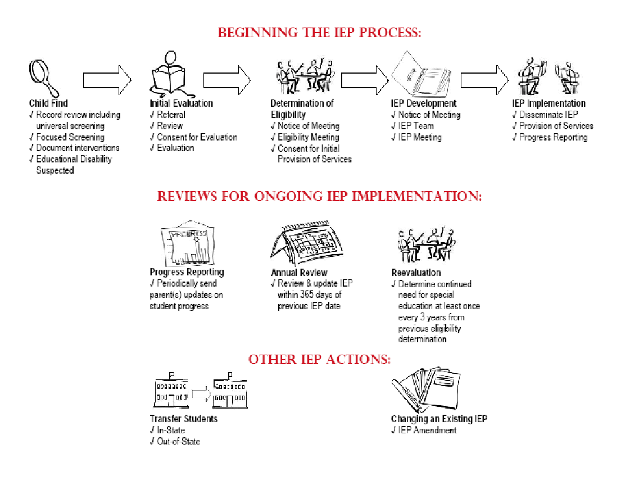
Notes:
10 Min.
Provide overview of the process (10 minutes)
Tool you can use as you train other audiences

Slide 6
IEP Meeting Participants
IEP Team Participants:
Parent
Student (if appropriate or 15+ - become student led in 9th grade)
General Education Teacher - At least 1 teacher or specialist with knowledge in suspected area of disability
Special Education Teacher
Special Education Director or Designee (can not be excused from the meeting)
As necessary: other qualified professionals such
as OT/PT, SLP, school psych, RN
Notes:
10 Min. to get through slide 29 (Excusal)
General Education Teacher must be a teacher of the student. If the student is not currently participating in a general education classroom but will be, a teacher of students of the same age can be the teacher
NOTE: Special Education Director or Designee
IDEA requires participation of a representative of the public agency who –
Is qualified to provide, or supervise the provision of, specially designed instruction to meet the unique needs of children with disabilities;
Is knowledgeable about the general education curriculum; and
Is knowledgeable about the availability of resources of the public agency [and has authority to commit resources]
PER ECEA, this individual CANNOT be excused from the meeting

Slide 7
Procedural Safeguards http://www.cde.state.co.us/spedlaw/download/2011ProceduralSafeguards.pdf
In these occasions:
Initial permission to evaluate
Due Process is requested
Disciplinary change in placement
Upon request
Annual meeting - parents should receive a copy of Procedural Safeguards annually
Notes:
WE are at 99% compliance with this! How do you document this when a parent is NOT in attendance at an annual or triennial? 7 out of 84 IEP reviews did not contain evidence of parents being provided procedural safeguards on an annual basis.

Slide 8
Procedural Safeguards
Key points to cover:
parent access to student records,
parent rights to ask that those records be amended,
parent rights to participate in groups and meetings where decisions are made about their child’s education,
parent notification requirements (prior written notice and the procedural safeguards notice), and
selected other safeguards (e.g., independent educational evaluation, surrogate parents, age of majority).

Slide 9
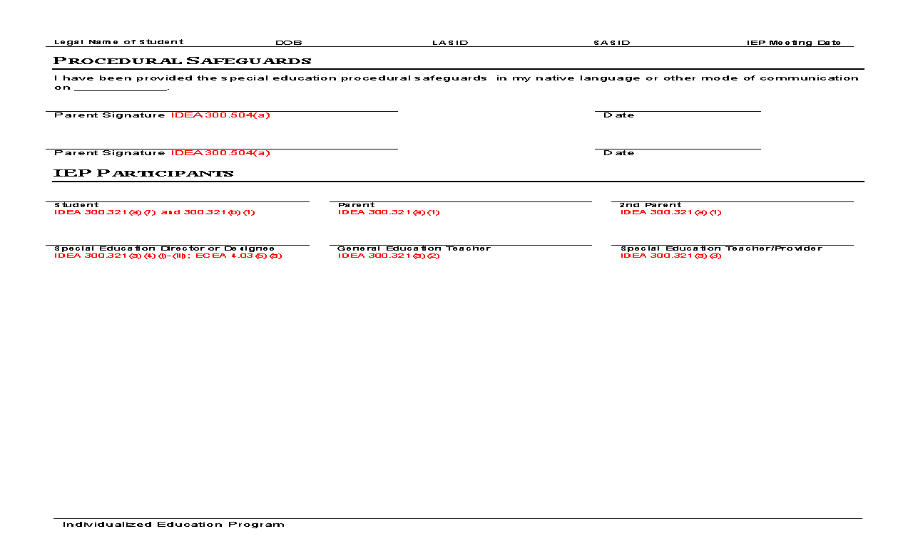
Procedural Safeguards

Slide 10
IEP Evaluation
Consider strengths and needs, as well as concerns about the student
Identify data Team already has, and data needed to determine eligibility
Prior Written Notice & Consent for Evaluation

Slide 11
PLAAFP
Data in PLAAFP suggests need(s) – get away from stating “See attached”
Statement of the child’s present levels of academic achievement and functional performance – compliance vs. quality (Appendix D – Pg. 135)
Statement about progress on goals and post secondary goals for Transition IEP’s

Slide 12
Annual Goals
Measurable goal should align directly to PLAAFP
Prioritize & consolidate goals as appropriate
Standard(s) reflected after goal
Unit of measurement (criteria) relate to skill being taught (SMART goals)
Objectives: Only required for students taking state
alternate assessment(s)
Notes:
30 Min. to get through slide 43 (Goals now)
Sybil’s need: reference evaluation report
PLAAFP= Present Levels of Academic Achievement and Functional Performance
Clarify that data reported in PLAAFP indicates needs and that these should be reflected in annual goals; provide a common thread
Goals are not standards but should be related to the student meeting benchmarks indicated by standards
Measures should be directly related to skills and may be percentages, number of demonstrations related to number of opportunities, etc.
Brainstorm for skills: how will they be measured
Skill: reading comprehension (percentage correct)
Skill: task completion (number of assignments completed of number of assignments given)
Skill: social initiation with peers (appropriate initiations within a period of time)
Skill: eliminate aggression toward peers

Slide 13
Goal Criteria
SMART Goal Criteria
Specific
Measurable
Achievable
Reasonable
Timeline
Notes:
Get out of Jail Free Card: 84 IEP reviews, only 6 IEP’s did not have smart goals! That is 1%. 99% are SMART!
SMART Criteria
What does it mean to be SMART and avoid special ed jail in writing annual goals?
Specific
Measurable
Achievable
Reasonable
Timeline

Slide 14
Goals -Link to State Standards
Make sure we are aligning goals to standards.
If we forget to align one goal, it will not meet compliance
Every discipline needs to be doing this
Examples: Appendix d – Pg. 12
CDE quotation “It is denial of FAPE if not making growth on annual goals year after year”. (year after year with same goal and lack of progress).
For Transition to Adulthood Focus on skills to be in place 12-24 months AFTER graduation.

Slide 15
Progress Reporting
Must report about the student’s progress toward achieving the annual goal
Include supporting data (e.g. graphs)
Completed as often as general education report cards
Notes:
26% of IEP’s reviewed last year did not have progress reports OR 22 out of 84 IEP’s reviewed did not have progress reports.
SLP team to complete progress reports on SEAS beginning 2011-2012 school year.

Slide 16
Accommodations vs.
Modifications

Slide 17
Accommodations

Slide 18
Modifications
Modifications are typically utilized for those students who are supported through Extended Services
We are making modifications to the standards so that the child can access the general curriculum
Resource students typically do not need any curricular modifications

Slide 19
Forms to be uploaded due to signatures
Permission for evaluation
Initial consent of Services
Amendment
Attendance at IEP meeting (parent also signs they received rights)
Eligibility determination disability pages

Slide 20
File Review Reminders
Statement of the child’s present levels of academic achievement and functional performance – compliance vs. quality
Statement about progress on goals and post secondary goals for Transition IEP’s
Concerns of the parent (remember this is not always negative) – link to PWN
Goals are measurable, reflected in present levels and aligned to standards
Statement describing whether the child will achieve local or individualized standards
Child is removed from regular education environment only when the nature or severity of the disability cannot be achieved satisfactorily even with supplementary aids and services
Notes:
Use dedacted file

Slide 21
Frontline
Dashboard
Notice of Meeting
Create an IEP
Progress Monitoring - how to
Uploading of documents
Finalizing - report to Records clerk
IEP Amendments
Batch printing
Audit logs
Tips: Administrator use can see who has accessed a student at anytime. If a student moves please turn in change of status.

Slide 22
Web Site Resources
Tour of www.slvboces.org
Indicator 13 Tips Manual
Related Services Providers

Slide 23
Parent Survey
Requirements/Information about Parent Surveys
Responsibilities of Case Managers

Slide 24
Question and Answer Getting our ducks in a row!

