Slide 1
The Effects of Affective Effectiveness on Effective Affects
OR…
Creating Affective Programming and Goals for Gifted Students isn’t as Hard as it Sounds
State Gifted Education Directors’ Meeting September 17, 2015

Slide 2
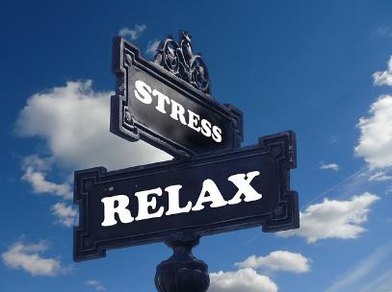
Today’s Outcomes
Know the affective dimensions and accompanying standards
Understand the strength based approach to affective goals and programming
Do: Practice writing affective goals

Slide 3
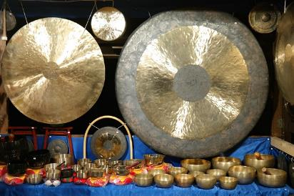
Group Norms
Be mindful of others
Listen when others are speaking
Participate when asked
Focus your mind
On the task at the moment
Away from distractions

Slide 4
Innate
Disgust, Anger, Fear
Sadness, Joy, Surprise
Learned
Optimism, Cooperation
Compassion, Empathy, Sympathy
Humility, Shame, Gratitude
Forgiveness
Patience
What do we know about the importance of affective support in student learning and growth?
There are many theories which attest to the connection between the affective domain and cognitive processing.
…when affective issues are addressed and social emotional needs met, students face their challenges with emotional balance and appropriate coping mechanisms that promote success in reaching personal potential (Roeper, 1995)
A Case for Affective Education: Addressing the Social and Emotional Needs of Gifted Students in the Classroom –sengifted.org
Many poor children simply do not have the repertoire of necessary social-emotional responses for school.
Eric Jensen

Slide 5
Gifted Education is Strength Based
Carol Dweck: Growth Mindset
The power of believing you can improve.
Upload video and clip from YouTube

Slide 6
Gifted Affective Needs are Predominantly Strength Based
Improve upon an affective strength
Investigate and prepare for college and career
Address, modify or eliminate an impediment (a hindrance or obstruction in doing something) to personal goals, academic goals or talent development.
Modify or eliminate impediment
Strength Based
Model
Investigate and prepare for college & career
Improve affective strength
Impediment Model

Slide 7
Adopt a Growth Mindset for Affective Development
Jaret Grossman: Master Motivator
Continually strive for improvement.
Upload video from Daily Life Motivation #190 on YouTube

Slide 8
Affective Programming is Predominantly Strength Based
Learning Experiences
Bibliotherapy/Cinema Therapy
Mentorships
Peer Discussion
Capstone Projects
Programs
Autonomous Learner Model
SENG Discussion Group
Interventions/Behavior Modification
Support Groups
Behavior Plan
Counseling
Interventions & Behavior Modification
Strength-based
Model
Programs & Models
Learning Experiences
Impediment Model

Slide 9
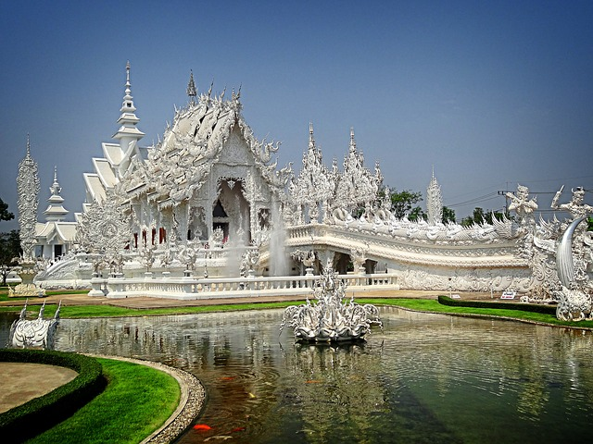
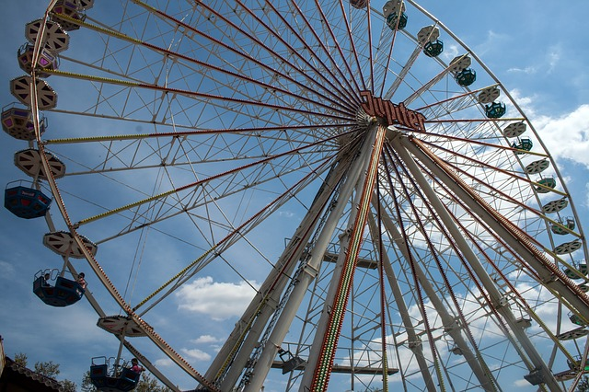
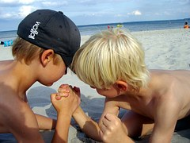
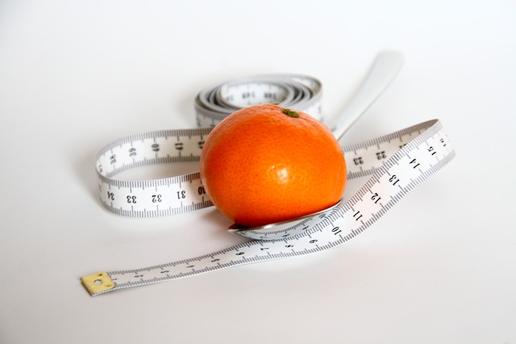
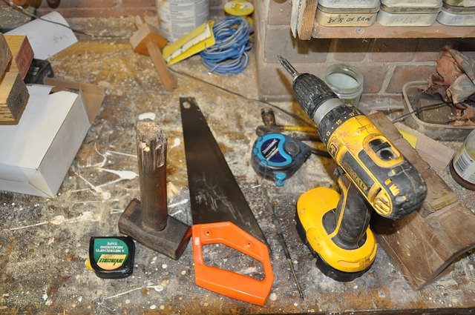
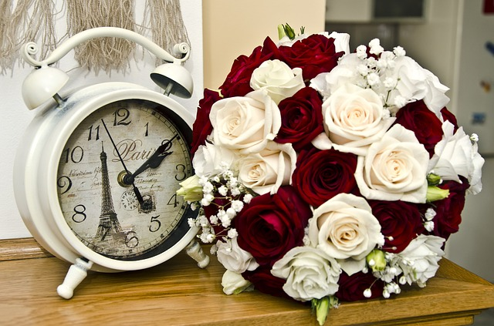
How do you measure …
Qualitatively

Slide 10
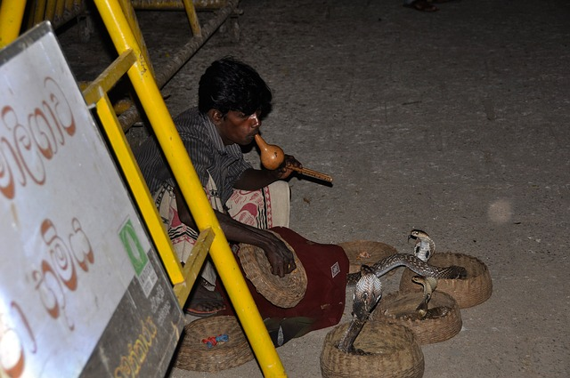
Qualitative Measures are Subjective
Subjectivity is the fact that experience is unobservable to everyone but the person having it. Daniel Gilbert
As are Affective Dimensions

Slide 11
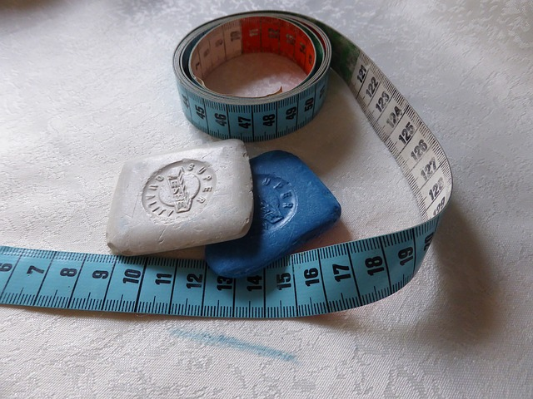
The Argument FOR Subjective, Qualitative, Soft Measures
…if we are purging ourselves of all things that afford us [an]… approximation of the truth, then we need to discard… psychology and the physical sciences … law, economics, and history as well.

Slide 12
Premise
Imperfect tools are a real pain, but they sure beat pounding nails with your teeth.
There is no measurement that adheres to a standard of perfection.
Accept a bit of fuzziness and stop complaining.

Slide 13
Premise
Of all the flawed measures of subjective experiences we can use, the honest, face to face report of an observant individual is the least flawed.

Slide 14
Premise
“…imperfections in measurement are always a problem, but they are a devastating problem only when we don’t recognize them.”

Slide 15
What is the best type of measurement for the situation?
Observation
To collect information related to certain events, activities or behaviors
You can download a video of Dian Fossey with search words “in loving memory of”

Slide 16
What is the best type of measurement for the situation?
Document (portfolio, product review, journal, etc.)
To gather specific, detailed information that can be evaluated by a rubric or other predetermined measure
You can download a video on Ann Frank from biography.com

Slide 17
What is the best type of measurement for the situation?
Document (portfolio, product review, journal, etc.)
To gather specific, detailed information that can be evaluated by a rubric or other predetermined measure
Interviews
Input gathered independently
You can download a video from the movie Erin Brockovich “Ugly shoes” and edit for language.
Notes:
Scenario, which qualitative evaluations are best? Imagine you have an irritating rash on your forehead, and you go to the doctor for some relief. Which would you rather the doctor do?

Slide 18
What is the best type of measurement for the situation?
Self-evaluation
Emotions, feelings, internal values
You can download a video clip from the movie Freedom Writers “You are not failing” and edit for language.

Slide 19
Affective Education is Guided by Standards
Colorado Career & Technical Education (CTE)
Personal Competence
Social Competence
NAGC
Communication Competence
Cultural Competence
Colorado Gifted Leadership Standards
Leadership
Colorado Health Standards
Colorado Civics
Standards

Slide 20
What are Student Outcomes for Affective Growth?
…it’s … difficult to see past all that achievement and potential to the [student] who may be filled with anxiety, … lonely, alienated, confused, and unsure of what the future might bring.
Delisle & Galbraith
4.1. Personal Competence.
Students with gifts and talents demonstrate growth in personal competence and dispositions for exceptional academic and creative productivity. These include self-awareness, self-advocacy, self-efficacy, confidence, motivation, resilience, independence, curiosity, and risk taking.

Slide 21
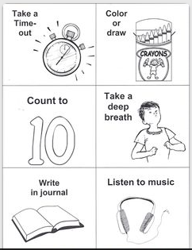
Personal Competence: Think: “Acceptance & Personal Responsibilities”
Meet challenges.
Know yourself.
Respect and tolerate diversity in your peers.
Develop a growth mindset that learns from mistakes.
Apply coping skills in a variety of settings.

Slide 22
What are Student Outcomes for Affective Growth?
Schools face the challenge of creating environments that are sensitive to a myriad of individual backgrounds and support all students' social and academic success.
Vincent, Horner, Sugai
4.2. Social Competence.
Students with gifts and talents develop social competence manifested in positive peer relationships and social interactions.
Developing Social Competence for All Students
http://www.hoagiesgifted.org/eric/e626.html

Slide 23
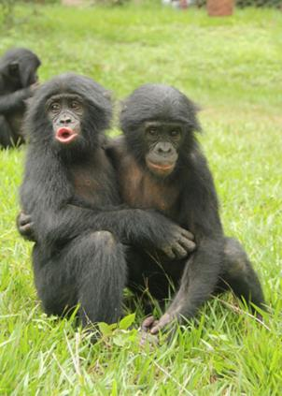
Social Competence Skills
Social Skills
Communication and interaction
Social Rules
Relations
Interpersonal Skills
People skills
Empathy
Respect
Communication skills
Persuasion
Active Listening
Leadership
One juvenile bonobo embraces another after the other lost a fight. Zanna Clay at Òlola ya Bonoboó

Slide 24
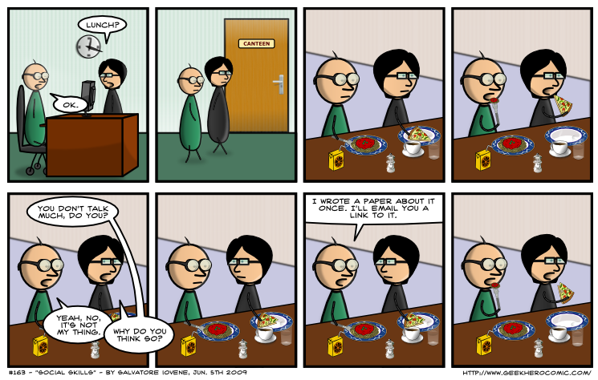
Social Competence: Think: “Student Interactions”
Practice solitude and social interaction.
Interact with intellectual and artistic/creative peers
Use social skills necessary for school, community and the world of work.

Slide 25
Application
Identification Scenarios
1 Affective SMART Goal Worksheets
NAGC Learning Environments Standards
Affective Competencies Matrix

Slide 26
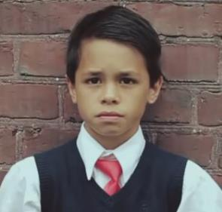
Write an ALP for Justin using the NAGC standards:
Personal Competence
Social Competence
Role Play in Pairs 5 min.
Teacher: Interview/Facilitate
Student: Share/Advocate
Collaborate on an ALP 5 min.
Use the Affective SMART Goal Worksheet
Table Share 5min.
Compare the goals created
Table lead fills out the Affective Competence Chart

Slide 27
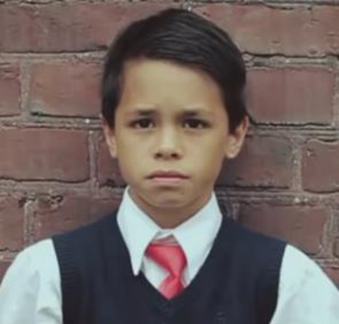
Did you find any areas where learning experiences, programming models, interventions and behavior modification might converge for Justin?

Slide 28
What are Student Outcomes for Affective Growth?
Studying the great minds in the arts, sciences, business, society and philosophy offers insights into what constitutes great leadership, and hopefully gives you ideas of where you might lead one day.
Carol Carter
Maureen Breeze
4.3. Leadership.
Students with gifts and talents demonstrate personal and social responsibility and leadership skills

Slide 29
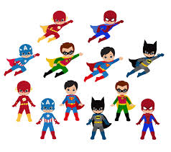
Leadership Competence: Think: “Student Roles & Responsibilities to Others”
Safely address social issues and personal responsibility.
Develop leadership skills in a variety of settings
Lead effective, positive change outside of school.

Slide 30
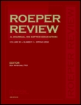
What are Student Outcomes for Affective Growth?
Roeper Review
Volume 23, Issue 4, 2001
Special Issue: Gifted Teachers: Teachers of Gifted Learners
4.4. Cultural Competence.
Students with gifts and talents value their own and others’ language, heritage, and circumstance. They possess skills in communicating, teaming, and collaborating with diverse individuals and across diverse groups. They use positive strategies to address social issues, including discrimination and stereotyping.

Slide 31
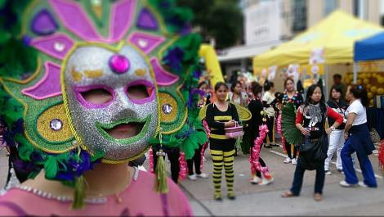
Cultural Competence: Think: “Exposure & Tolerance”
Appreciate and be sensitive to diverse backgrounds and languages.
Eliminate discriminatory language and behavior.
Collaborate with diverse peers.
KC Wong. Creative Commons BY-NC (cropped).
Notes:
Cultural diversity examples

Slide 32
Application
Identification Scenarios
Other side of Affective SMART Goal Worksheets
NAGC Learning Environments Standards
Affective Competencies Matrix

Slide 33
Write an ALP for Lisa using the NAGC standards:
Leadership
Cultural Competence
CHANGE PARTNERS & ROLES
Role Play in Pairs 5 min.
Teacher: Interview/Facilitate
Student: Share/Advocate
Collaborate on an ALP 5 min.
Use the Affective SMART Goal Worksheet
Table Share
Compare the goals created
Table lead fills out the Affective Competence Chart

Slide 34
Are you seeing any trends in the origin of the goals you created for two scenarios?

Slide 35
What are Student Outcomes for Affective Growth?
A work of art is an expression of the artist’s vision made possible by the actions of his or her imagination….Acts of interpretation enable individuals to discern the work in relation to the cultural and social worlds it mirrors.
Arthur D. Efland
4.5. Communication Competence.
Students with gifts and talents develop competence in interpersonal and technical communication skills. They demonstrate advanced oral and written skills, balanced biliteracy or multiliteracy, and creative expression. They display fluency with technologies that support effective communication.

Slide 36
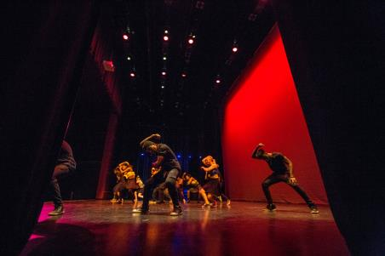
Communication Competence: Think Student Products
Develop and maintain first and second language(s)
Experience oral, written and artistic forms of communication that recognize students’ cultural context.
Use of variety of tools to express critical and creative thinking.

Slide 37
What are Student Outcomes for Affective Growth?
“Essential Skills Content Standards” from the
“…characteristics of gifted students that affect their college planning….are multipotentiality and sensitivity to competing expectations.
Sandra L. Berger
Colorado Community College System

Slide 38
College & Career: Think: “Investigate & Prepare”
Acquire skills to investigate the world of work in relation to self and career decisions.
Use strategies to achieve future career goals.
Understand relationship between personal qualities, education, training and the world of work.
ICAP Promising Practices; Career Standards & Indicators http://www.cde.state.co.us/sites/default/files/icappromisingpractices/CAREER%20STANDARDS%20AND%20INDICATORS.pdf

Slide 39
Application
Identification Scenarios
1 Affective SMART Goal Worksheet
NAGC Learning Environments Standards
Affective Competencies Matrix
Postsecondary Workforce Ready graphic
Sample CTE Standards

Slide 40
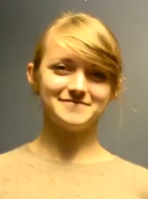
Write an ALP for Yulia using the NAGC or CTE standards:
Communication
College & Career
CHANGE PARTNERS & ROLES
Role Play in Pairs 5 min.
Teacher: Interview/Facilitate
Student: Share/Advocate
Collaborate on an ALP 5 min.
Use the Affective SMART Goal Worksheet
Table Share
Compare the goals created
Table lead fills out the Affective Competence Chart

Slide 41
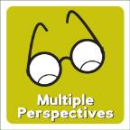
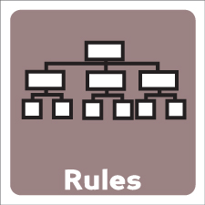
Did your group use any spoken or unspoken rules when dealing with teacher and student perspectives to arrive at consensus on a goal?

Slide 42
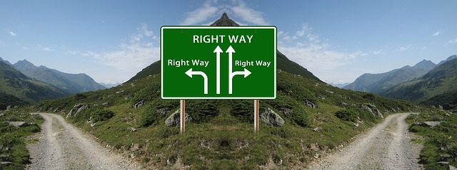
There are many roads to meaningful ALP goals

Slide 43
Application
Identification Scenarios
1 Affective SMART Goal Worksheet
NAGC Learning Environments Standards
Affective Competencies Matrix
Postsecondary Workforce Ready graphic
Sample CTE Standards

Slide 44
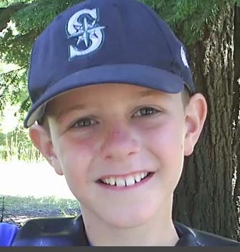
Write an ALP for Dustin using any of the NAGC or CTE standards that best fit his needs.
Role Play in Pairs 5 min.
Teacher: Interview/Facilitate
Student: Share/Advocate
Collaborate on an ALP 5 min.
Use the Affective SMART Goal Worksheet
Table Share
Compare the goals created
Table lead fills out the Affective Competence Chart

Slide 45
What is the big idea you are walking away with today about writing affective ALPs?

Slide 46
The Ultimate Affective Goal
https://www.youtube.com/watch?v=kZlXWp6vFdE
Notes:
Our job as teachers and parents is not to protect our children from pain and failure, but to teach them how to face and overcome them through a growth mindset.

